Slide 1
FINAL PROJECT
Fiston Kadetwa BAHATI
Information Technology and Networking/Cyber Security, DeVry University
SEC285: Fundamentals of Information System Security - 62055
Professor Rami Salahieh
April 23, 2025

Slide 2
In this project, I will explain through screen shorts, the fundamentals of information security attacks and defense mechanisms that provides insight into designing security solutions and policies.
This course helped me gain knowledge that can allow me to know the type threats, how to detect them, ways to troubleshoot them and how to prevent them from damaging a system.

Slide 3
Asymmetric Key Encryption
In the following slides, you will find that I explored technical and administrative controls using encryption.
Also, you will see what I did when implementing file management. I implement file management when I wanted to mitigate risks that could affect data assets of the enterprise or companies.

Slide 4
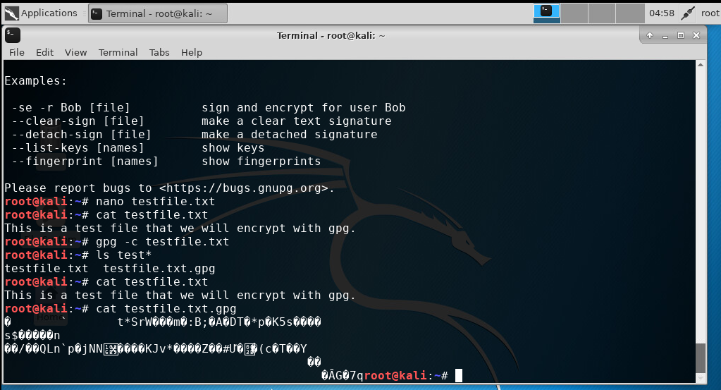
File Encryption
This screenshot should show the following.
Content of the plaintext file
Content of the encrypted file

Slide 5
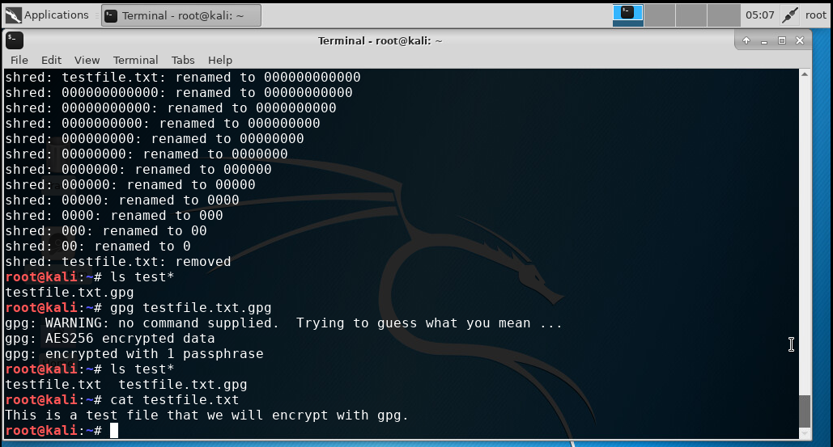
File Decryption
This screenshot should show the following.
The encrypted file being listed by itself
The decrypting process
Both the encrypted file and the original plaintext file being listed

Slide 6
Stateful Firewall
The following slides of this project show how firewall is used to protect enterprise computing resources from attacks.

Slide 7
Question
What effect does the sudo iptables --policy INPUT DROP command have on the access to computing resources?
Answer here:
Security: Enhances security by dropping all unsolicited incoming traffic.
Connectivity: Requires careful configuration to avoid blocking essential services.
Management: Regularly review and update rules to ensure necessary access while maintaining security.

Slide 8
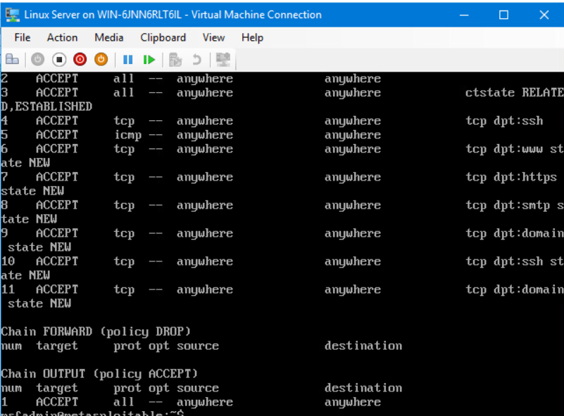
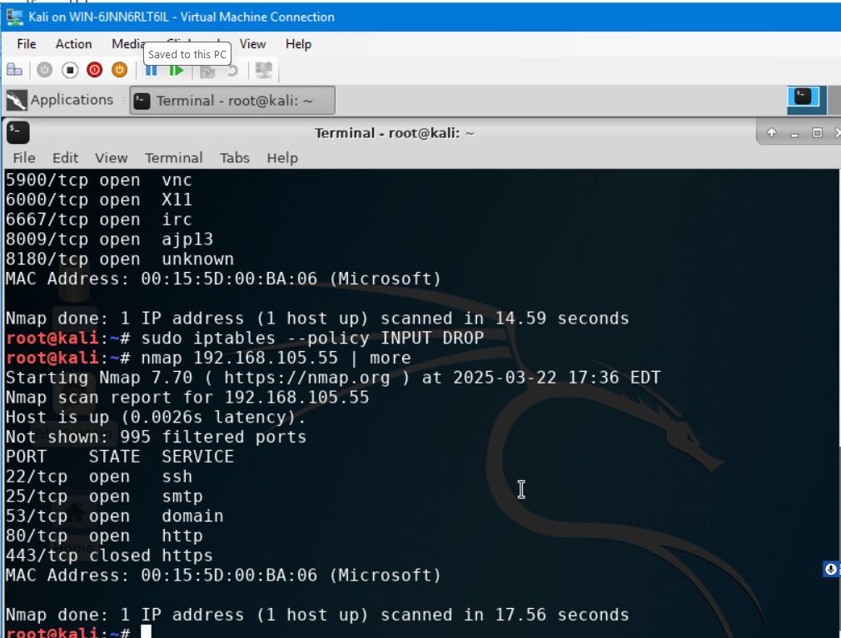
Nmap Scan
This screenshot should show the Nmap scan result of the Linux Server VM.

Slide 9
Bring Your Own Device (BYOD) Security Policy
The following project slides show the created Bring Your Own Device (BYOD) security policy for ABC Corporation based on a SANS security template
(You can also click on the Microsoft Word file below attached to explore more)

Slide 10
Overview:
With the current technological revolution, almost everything uses electronic devices such as Tablets, smartphones, and Laptops to perform different tasks. Everything is being digitalized; thus, the use of electronics has become wide.
2. Purpose:
The discovery of any vulnerabilities helps reduce the attack vector on an organization’s computing resources in the sense that the discovery will allow the technicians to take care of it by imagining a prospective solution to that attack and, the discovery will allow them to plan about how to solve the problem and the time frame that it will take. The technician will have the time to save some important files that are sensitive. The policy will help them follow the procedures to take while saving the system. It will also contain the restrictions and regulations regarding the use of external devices by employees and or personnel that will be followed during the operation.

Slide 11
3. Scope:
BYOD continues to evolve especially when remote work becomes more and more common. It is convenient and moral for the employee. But there are some risks that come with using unsanctioned devices in the enterprise.
4. Policy:
Organizations or entities must consider the following steps when establishing a policy:
Regulatory considerations.
The policy must follow the relevant data retention regulations such as HIPA; Sarbanes- Oxley Act; GDPR or any other industry regulations.
Security
This must enforce encryption on BYOD. And also consider segregating business and personal information, controlling network traffic and access to undesirable sites if possible and factoring a physical data egress point like SD card, mobile user privacy.
Application management
Enterprise can remove their applications and associated data if needed from employee’s devices since they cannot wipe data from their devices.

Slide 12
5. Policy Compliance:
Entities might use containers as the only point of access to company information with containerization. This means that all enterprise data is deleted from the employee’s device. Even if you do not comply with the policy, you will not have access to the enterprise’s data.
6. Related Standards, Policies, and Processes:
BYOD policy should define regular audits for security enforcement. This means knowing the users that are operating within the bounds of computing policies and compliance obligations. For the non-BYOD enterprises, they must make sure that only corporate-owned devices can connect to enterprise networks.

Slide 13
7. Definitions and Terms:
BYOD stands for Bring Your Own Device.
Mobile devices are as follow: Laptops, tablets, phones…
CIA stands for Confidentiality, Integrity and Availability.
8. Revision History:
Date of change | Responsible | Summary of change
August 2019 | SANS policy team | Updated and converted to new format
March 2025 | Fiston K. BAHATI | Updates

Slide 14
Multifactor Authentication (MFA)
In this project, You will see how I implemented security controls to protect enterprise computing resources, by using multifactor authentication (MFA).

Slide 15
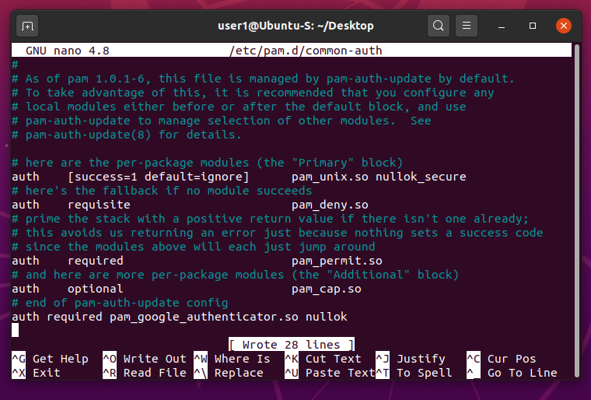
Common-auth Configuration File
This screenshot should show the entry that indicates the use of the Google Authenticator module.

Slide 16
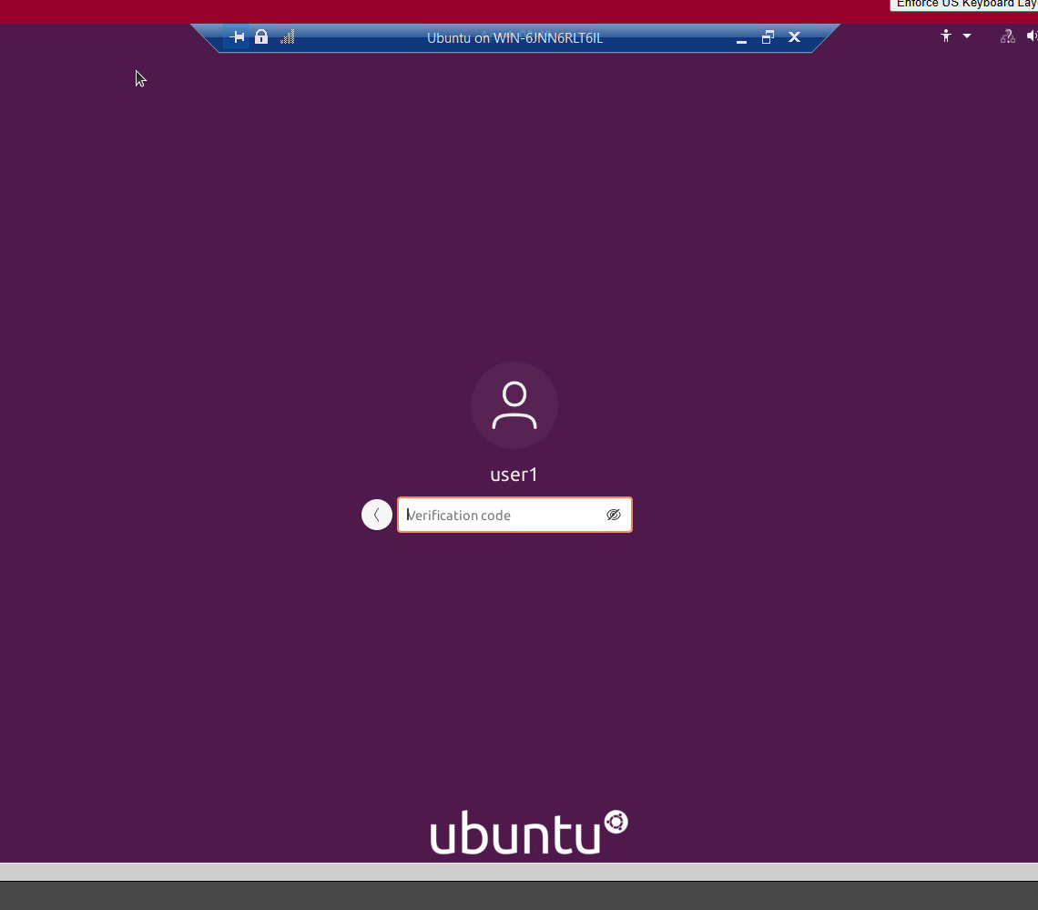
MFA Logon Screen
This screenshot should show the logon screen where a verification code is required.

Slide 17
Vulnerability Assessment
The following slides show four vulnerability assessment tools which are:
Nmap
NetCat
Wireshark
Nessus

Slide 18
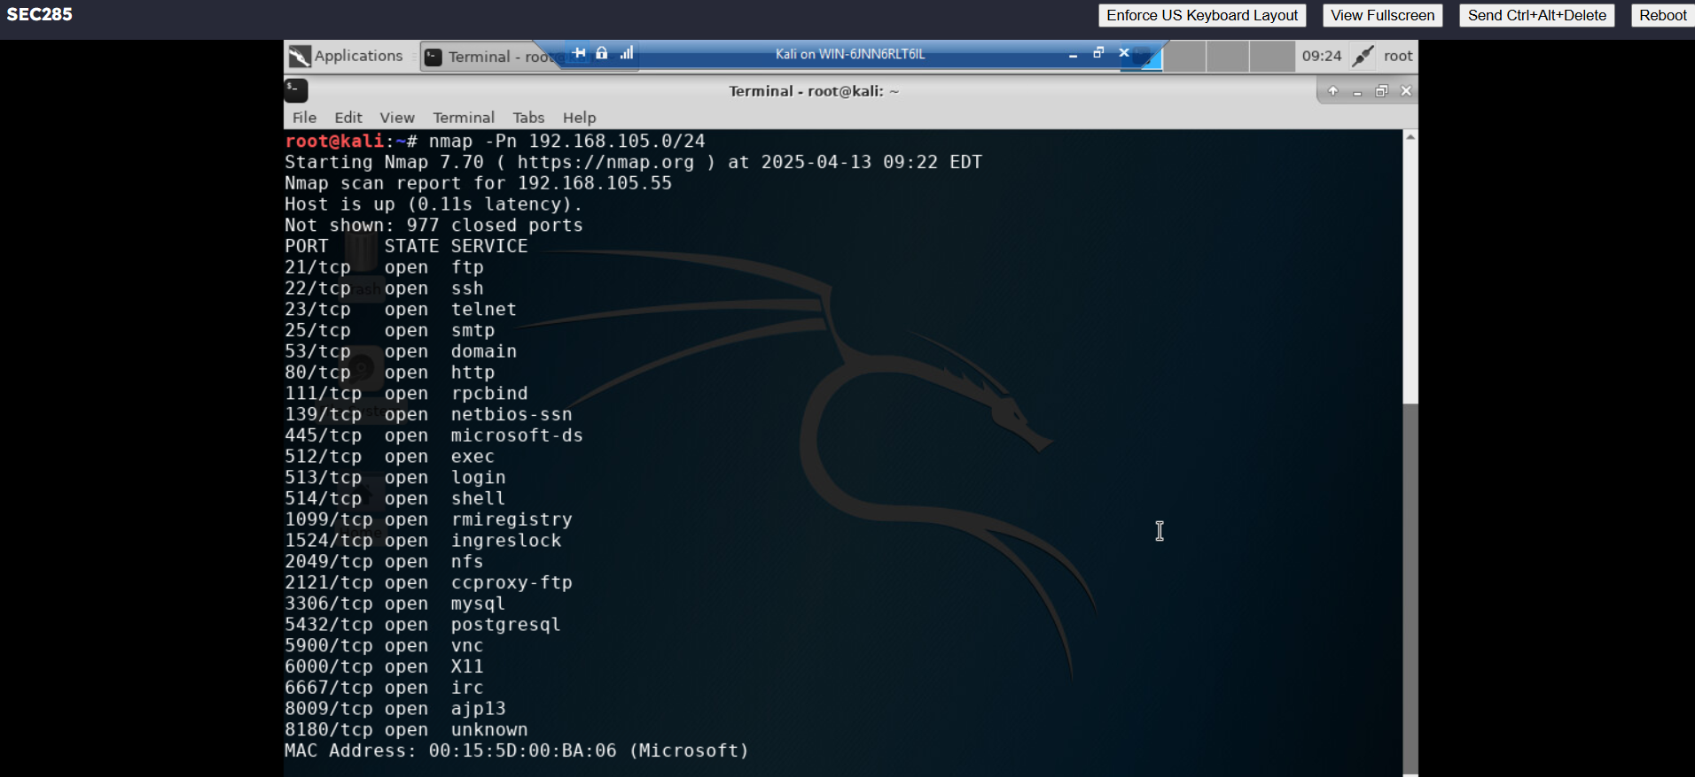
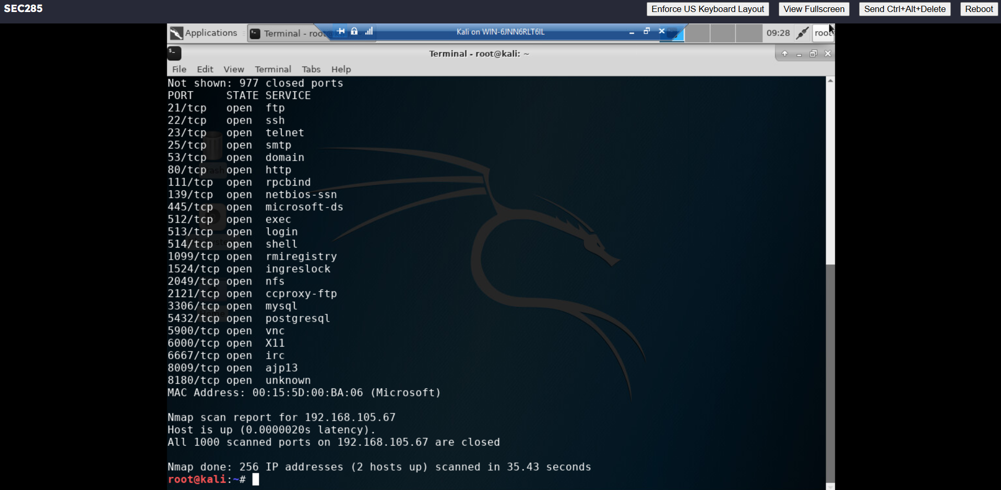
Nmap
This screenshot should include the scan result showing both the Kali and Linux Server VMs.

Slide 19
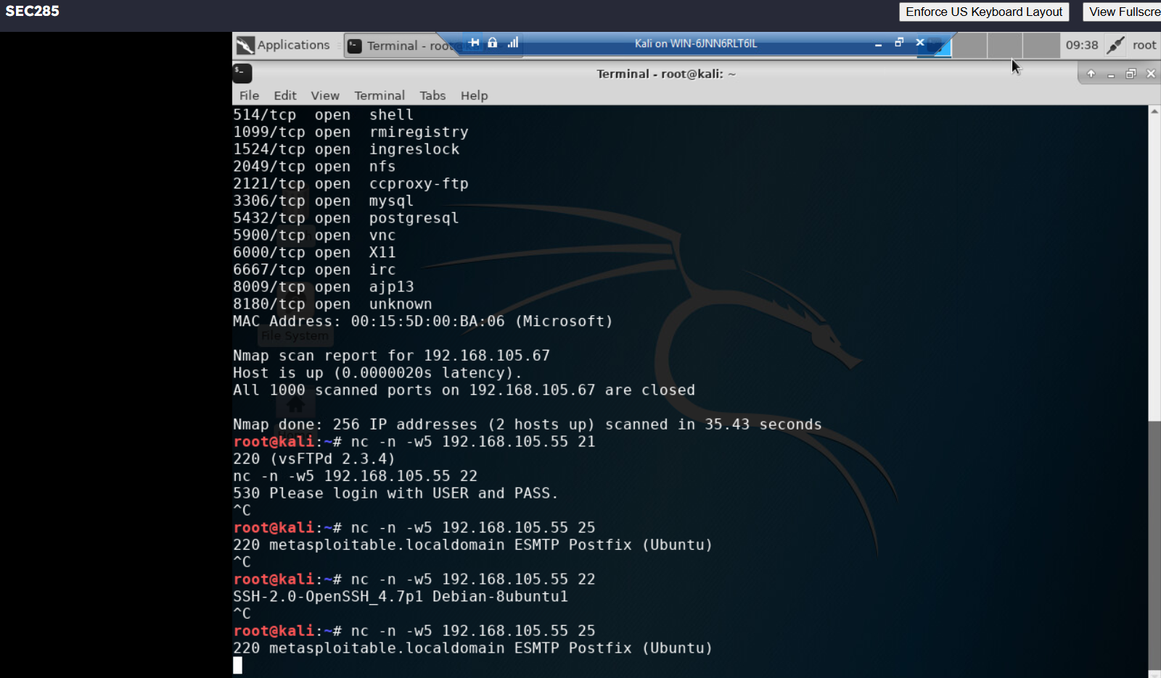
NetCat
This screenshot should include the scan result showing both the Kali and Linux Server VMs.

Slide 20
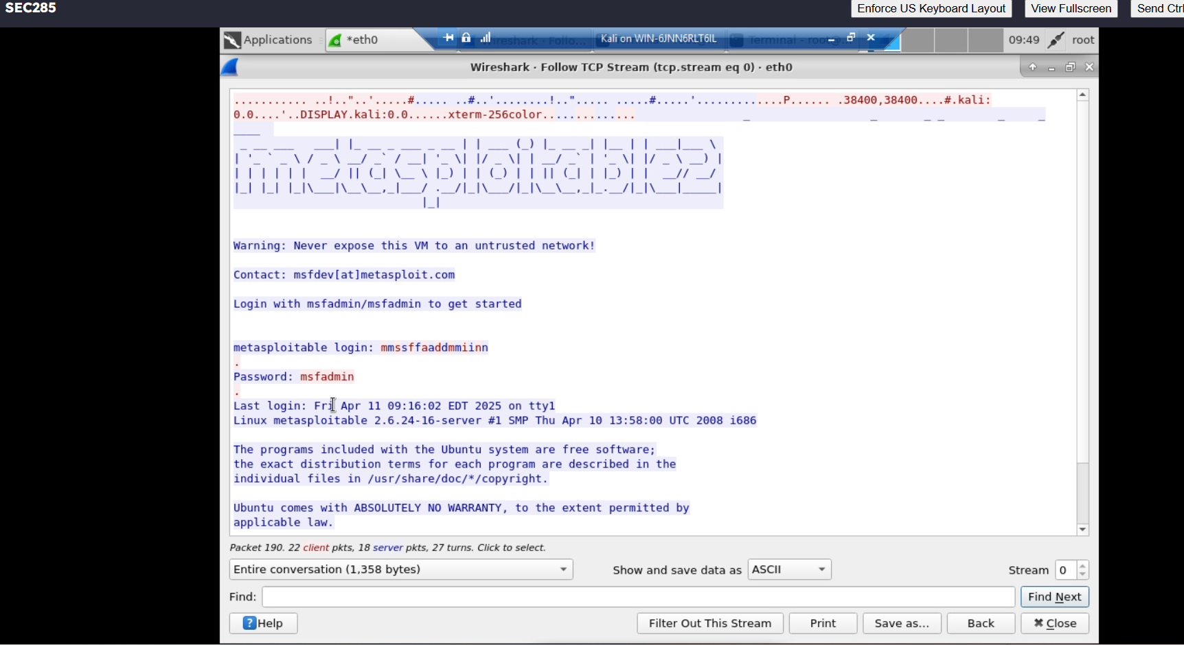
Wireshark
This screenshot should include the Wireshark—Follow TCP Steam window showing the Telnet username and password.

Slide 21
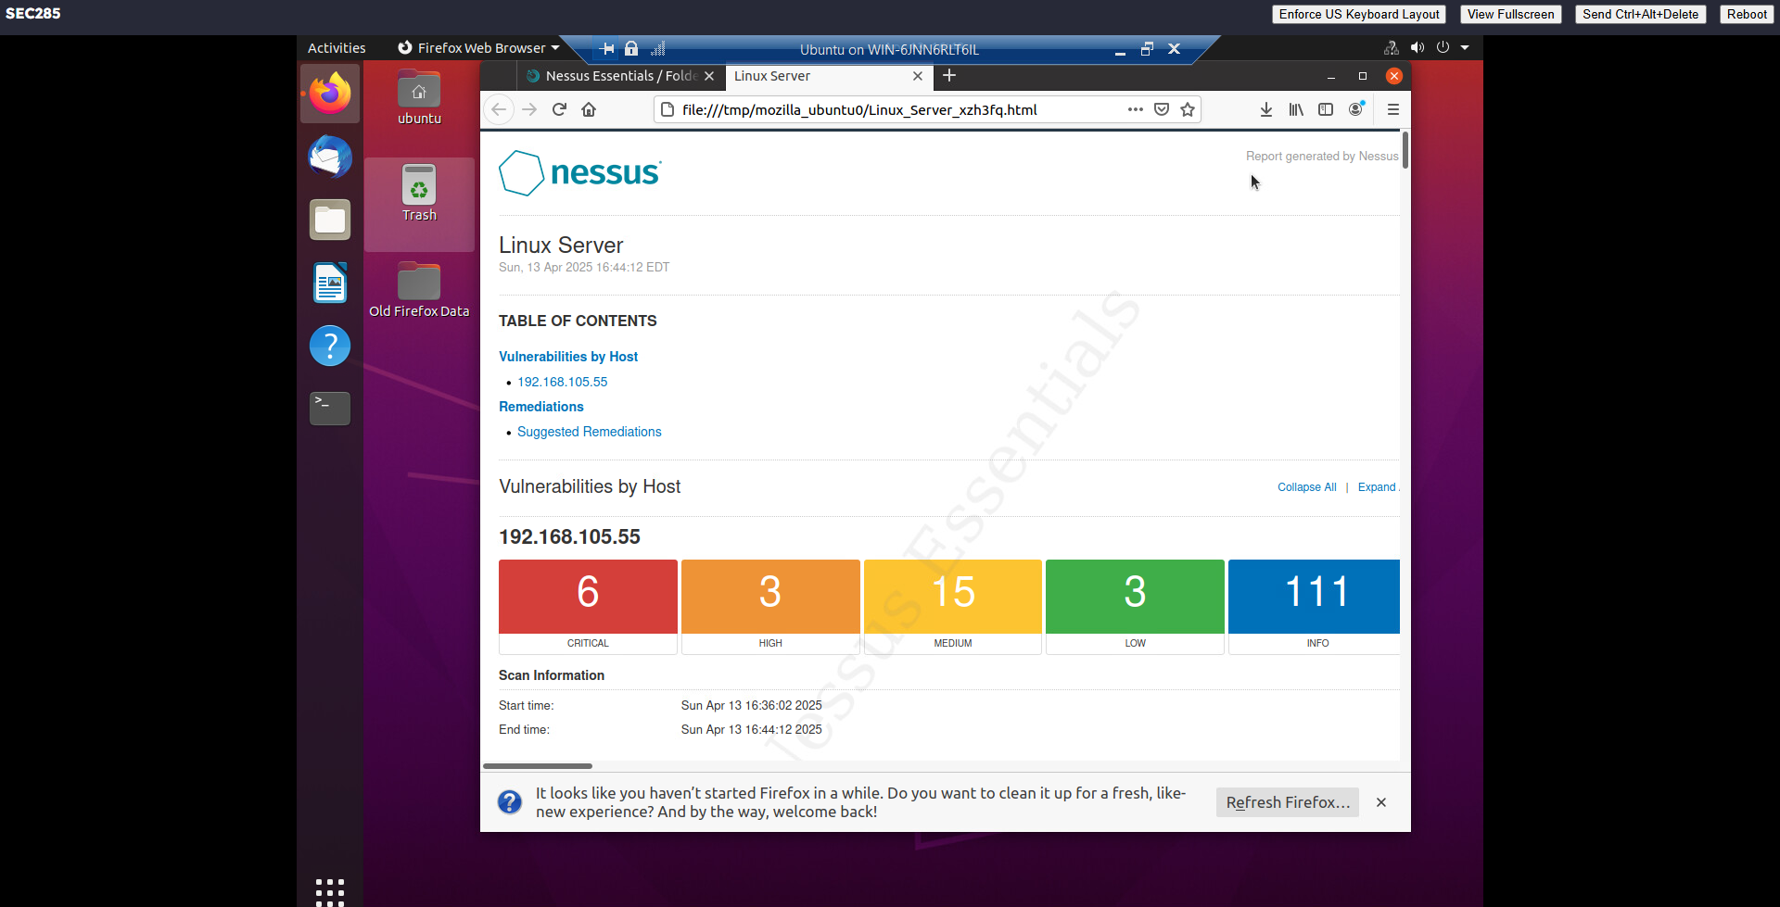
Nessus
This screenshot should include the high-level view of the Nessus vulnerability scan report (showing categories of vulnerability in different colors).

Slide 22
CHALLENGES, SOLUTIONS AND REFERENCE
Challenge:
I skipped a page on the guide that contained the username and password; I was stacked and could not go to the other steps.
Solution:
I watched the recording of our live lesson and repeated the process. Repetition is very important when someone gets stacked.
REFERENCE:
CompTIA Security+ Guide to Network Security Fundamentals 6e: Virtual Machine Lab: Videos of
Modules 2, 3, 4, 5, 6

