Slide 1
This project, as detailed in different slides, spans multiple advanced modules in networking and communication systems.
The slides covers several modules from my NETW310 course, each focusing on critical areas of signal processing, wireless communication, and network infrastructure. These modules combine theoretical knowledge with practical implementation, showcasing my ability to work with industry-standard tools and apply complex concepts to real-world scenarios.
Skills Demonstrated in this project are as follows:
Each module helped me gain a couple of skills that I will detail in each module.
Competence
Across these modules, I demonstrate:
Strong Theoretical Foundation: Mastery of modulation, coding, and RF principles.
Practical Expertise: Hands-on experience with oscilloscopes, spectrum analyzers, Multisim, and MATLAB.
Analytical & Problem-Solving Skills: Ability to interpret complex data and validate theoretical models.
Technical Communication: Clear documentation of processes and results.

Slide 2
NETW311 Course Project
Module 2
Baseband Signals and AM/FM Signals

Slide 3
The following slides will be focusing on Baseband Signals, AM (Amplitude Modulation), and FM (Frequency Modulation). The tasks involve practical signal analysis using tools like Oscilloscope and Spectrum Analyzer, along with theoretical work such as developing equations for modulated signals.
Skills Demonstrated in this project are as follows:
Signal Analysis & Measurement: Using spectrum analyzers and oscilloscopes to capture and interpret signals.
Mathematical Modeling: Deriving and applying modulation equations for AM and FM.
Frequency-Domain Understanding: Recognizing harmonics, sidebands, and carrier frequencies.
Technical Documentation: Organizing data in tables, screenshots, and plots for clear presentation.
Competence
This project allowed me to show what I can do as a technology expert:
Practical Expertise: Hands-on experience with real-world tools (oscilloscope, spectrum analyzer).
Theoretical Knowledge: Strong grasp of modulation techniques and signal behavior.
Analytical Skills: Ability to interpret complex data and translate it into actionable insights.
Communication: Clear documentation of technical processes, which is critical for IT and networking roles.

Slide 4
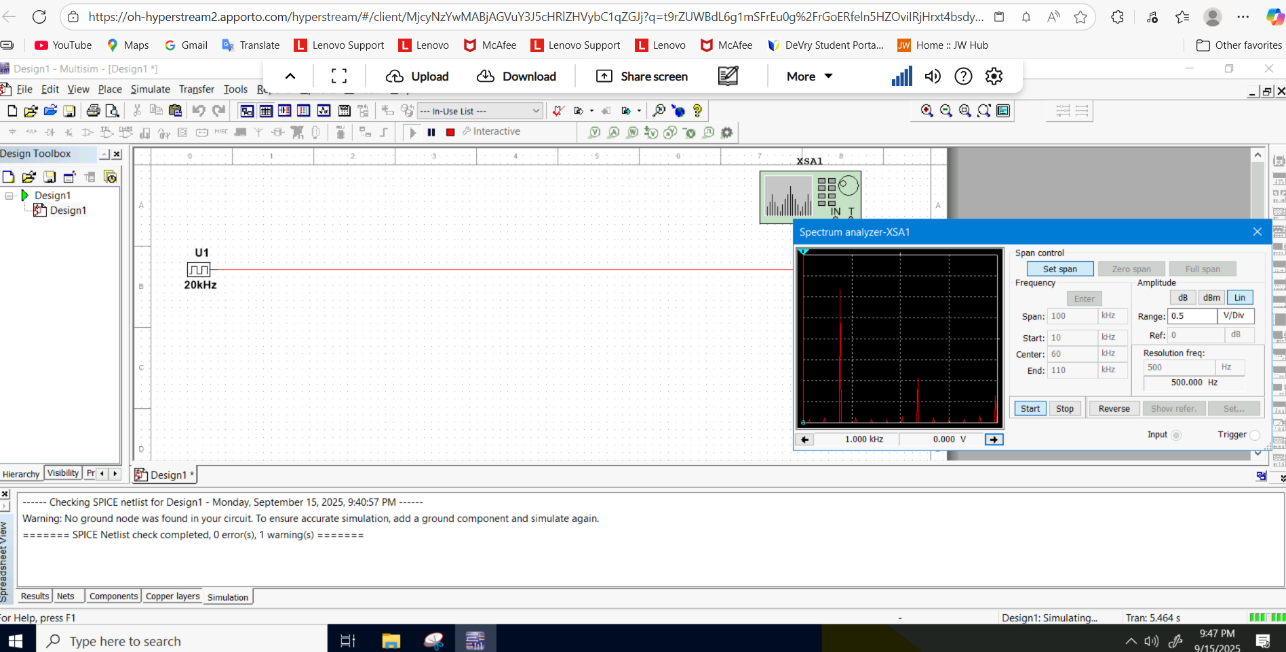
Baseband Signals
The screenshot should show the spectrum analyzer displaying the signal’s harmonic spectrum and its panel settings. Record the signal voltage at each of the frequencies in the table.
SCREENSHOT HERE
Harmonic Frequency | Signal (Volts)
20 kHz | 1.714 V
40 kHz | 0.000 V
60 kHz | 868.903 V
80 kHz | 0.000 V
100 kHz | 254.396 V

Slide 5
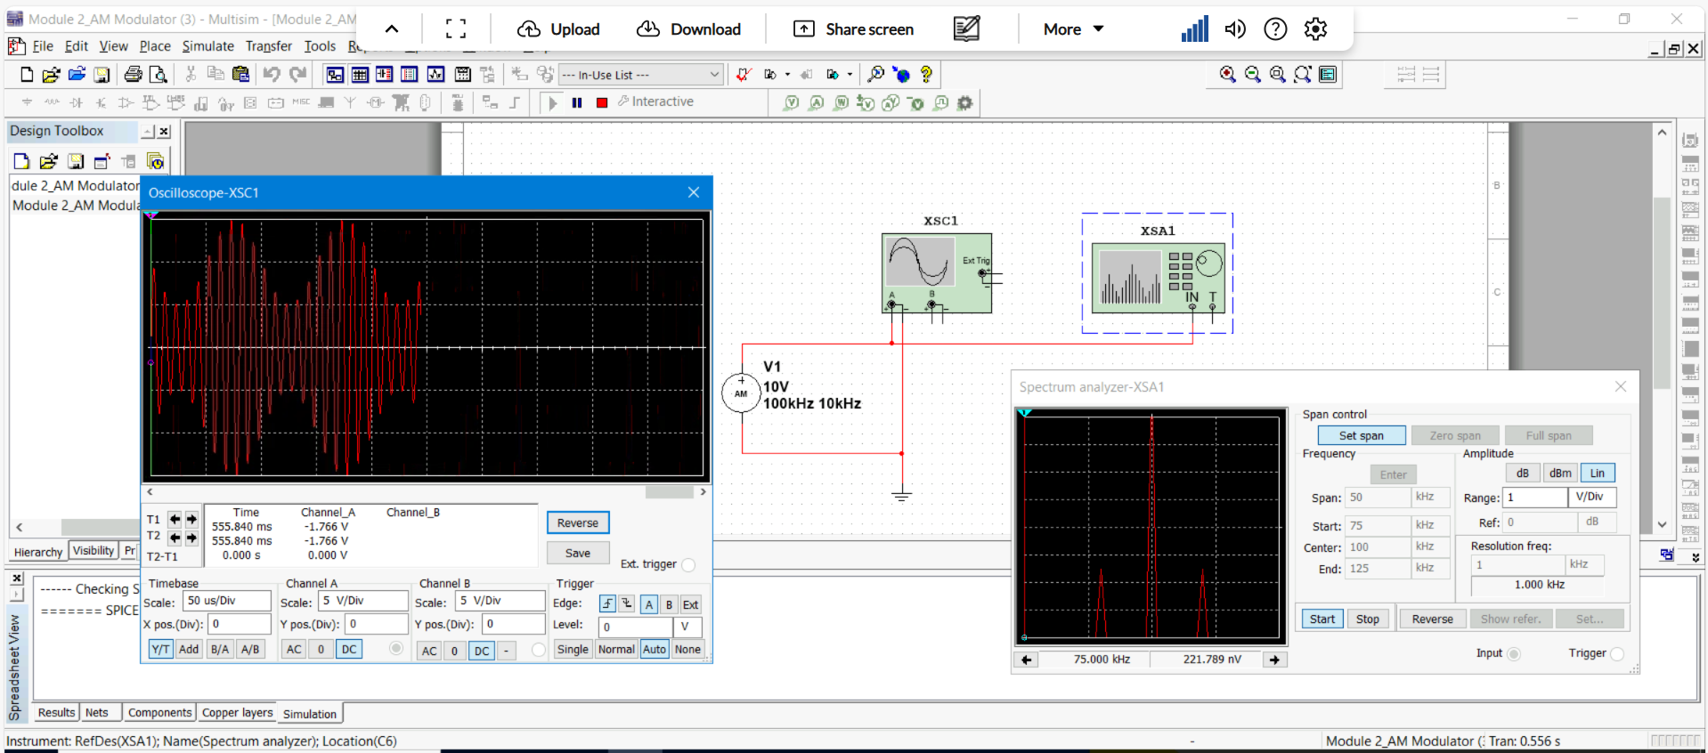
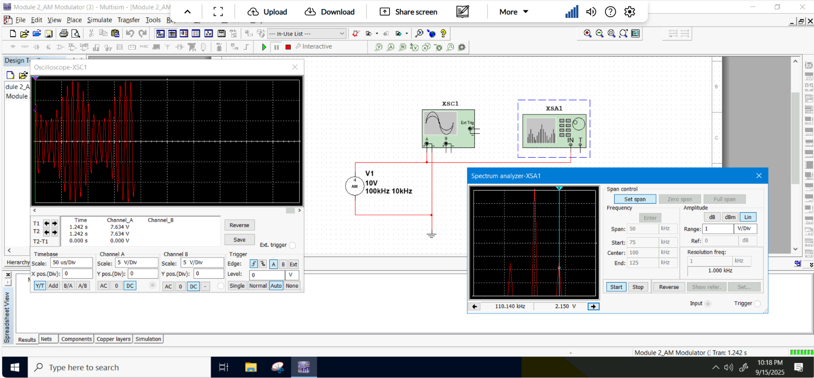
AM Signals
The screenshot of the Oscilloscope should include the signal and the panel settings of the oscilloscope. The screenshot of the Spectrum Analyzer should include the signal and the panel setting of the analyzer.
Oscilloscope screenshot here
Spectrum Analyzer screenshot here
AM Modulation | Frequency (kHz)
Lower side band | 90 kHZ
Carrier | 100 kHz
Upper side band | 110 kHz

Slide 6
AM Signals Cont.
Develop equations for the carrier and modulating signals and plot the equation for the composite modulated signal V_{AM .}
Equations here:
Carrier frequency is fc; Carrier voltage is vc; Peak is Vc
vc = Vc sin (2𝜋𝑓𝑐𝑡 + 𝜃𝐶 ) => vc = 10 sin (2𝜋100𝑡 + 𝜃𝐶 )
Information frequency is fi; Information voltage is vi; Peak is Vi
Vi = Vi sin(2𝜋𝑓𝑖𝑡 + 𝜃𝑖) => vi = 5 sin (2𝜋10𝑡 + 𝜃𝐶 )
And
𝑣𝐴𝑀 = [𝑉𝑐 + 𝑉𝑖 sin(2𝜋𝑓𝑖𝑡 + 𝜃𝑖)][ sin(2𝜋𝑓𝑐𝑡 + 𝜃𝐶 )] =>
𝑣𝐴𝑀 = [10 + 5 sin(2𝜋10𝑡 + 𝜃𝑖)][ sin(2𝜋100𝑡 + 𝜃𝐶 )]
Plotted diagram screenshot here:

Slide 7
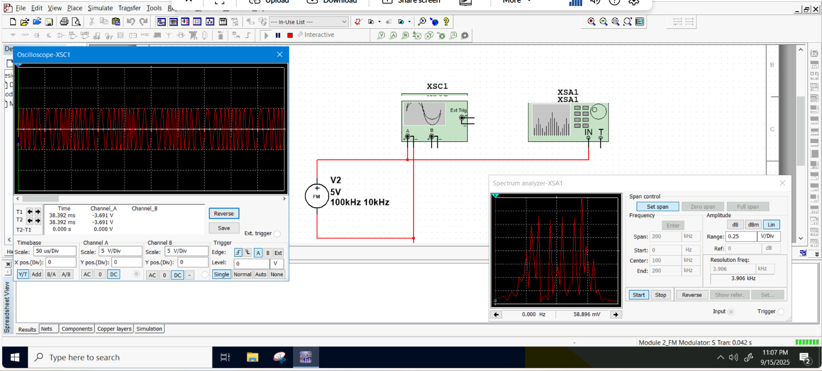
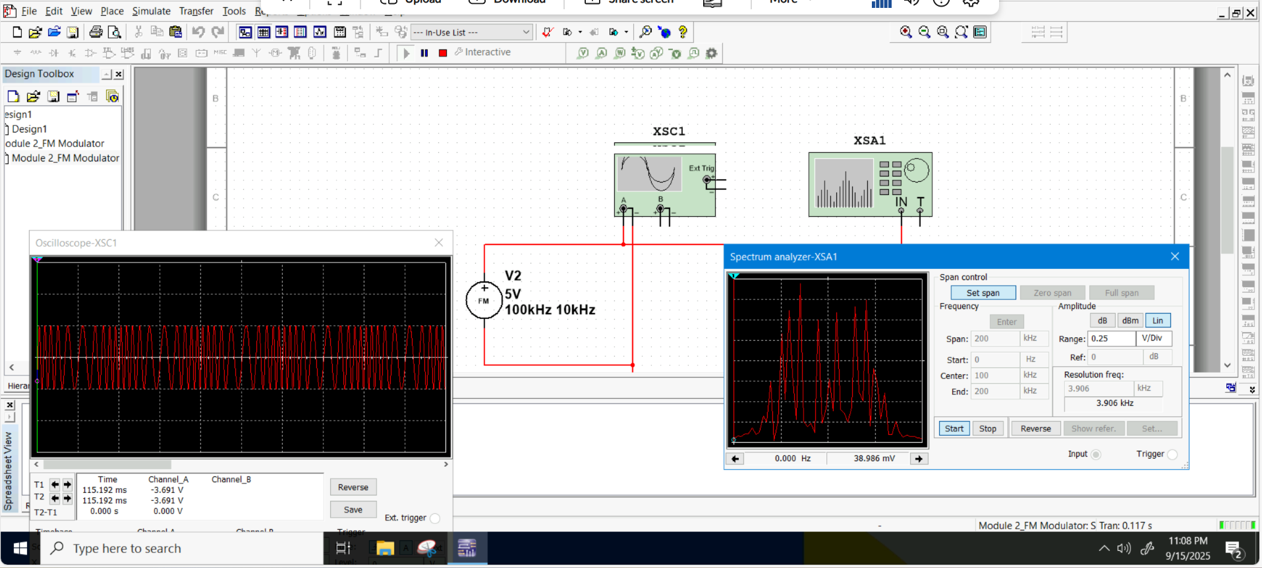
FM Signals
The screenshot of the Oscilloscope should include the signal and the panel settings of the oscilloscope. The screenshot of the Spectrum Analyzer should include the signal and the panel setting of the analyzer.
Oscilloscope screenshot here
Spectrum Analyzer screenshot here
What’s the carrier frequency?
0 Hz; 100 kHz and 200 kHz

Slide 8
NETW310 Course Project
Module 3
Pulse Code Modulation (PCM) and Line Codes

Slide 9
This project focuses on Pulse Code Modulation (PCM) and Line Coding techniques, which are fundamental in digital communication systems. I performed practical simulations using Multisim and MATLAB, analyzed signal behavior, and answered theoretical questions about sampling and bandwidth.
Skills Demonstrated in this project are as follows:
Digital Signal Processing Expertise: Practical application of PCM and line coding concepts.
Simulation Tools Proficiency: Hands-on experience with Multisim and MATLAB, essential for engineering and IT roles.
Analytical & Problem-Solving Skills: Evaluating trade-offs in sampling and encoding for performance optimization.
Technical Communication: Clear documentation of findings and theoretical explanations.
Competence
As a technology expert this project allowed me to show my competence such as:
Deep understanding of core networking and communication principles.
Combines theory with practical implementation
Reflects ability to work with industry-standard tools and interpret complex data accurately
Ability to use MATLAB for signal visualization and analysis.
Knowledge of digital encoding schemes, their impact on bandwidth, and implications for network design.

Slide 10
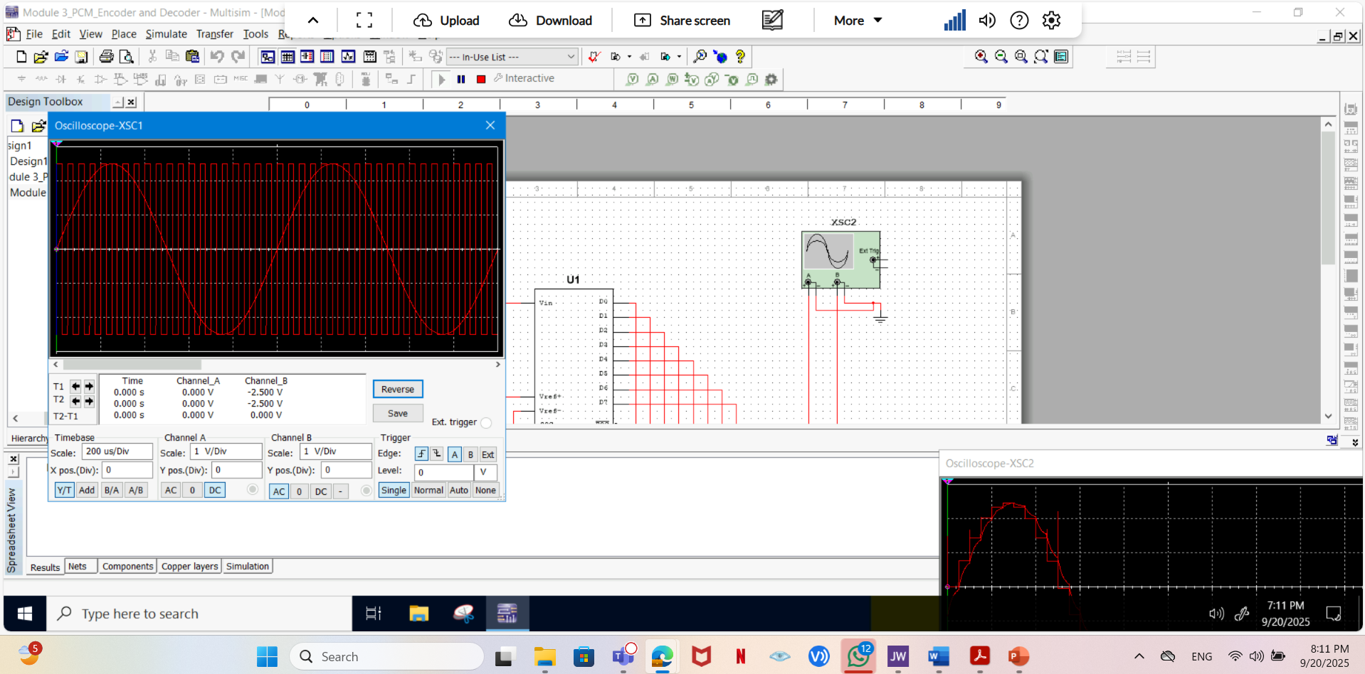
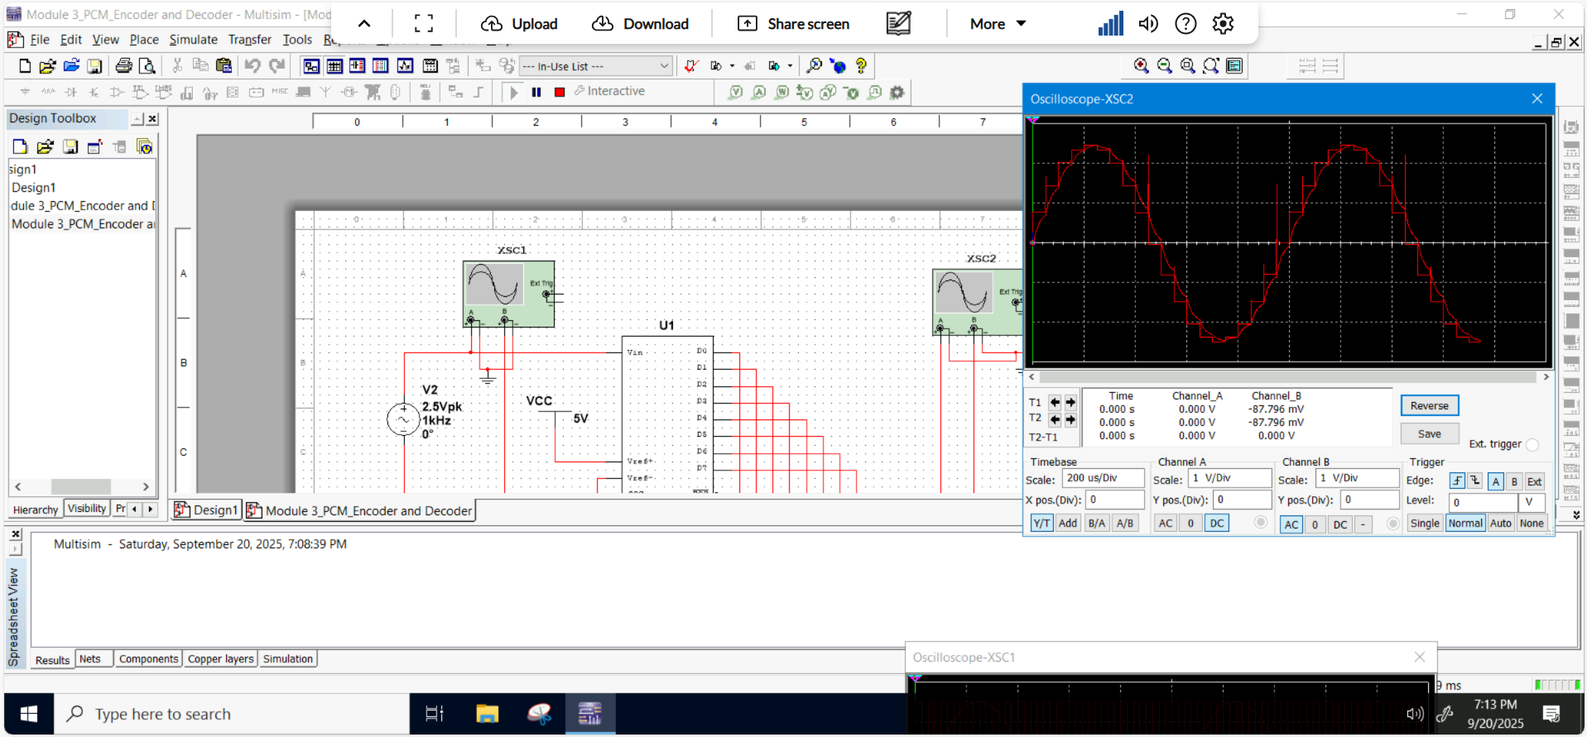
Pulse Code Modulation (PCM)
The first screenshot should show the Oscilloscope-XSC1 display with the analog input signal and sampling clock at the input to the ADC. The second screenshot should show the Oscilloscope-XSC2 display with the output of the DAC.

Slide 11
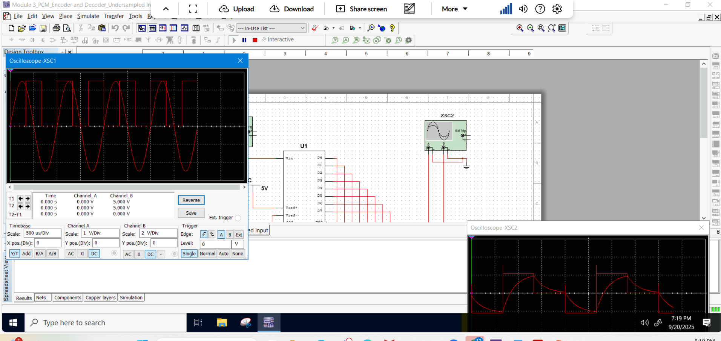
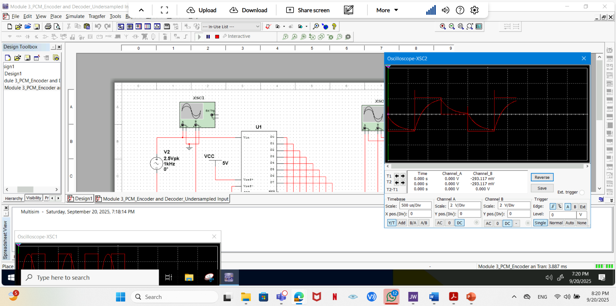
Pulse Code Modulation (PCM)
The first screenshot should show the Oscilloscope-XSC1 display with the analog input signal and sampling clock at the input to the ADC. The second screenshot should show the Oscilloscope-XSC2 display with the output of the DAC.
What are the effects of increasing or decreasing the sampling rate?
Answer:
Increasing captures more data points per unit time, which resulting in a more detailed and accurate digital representation of the original analog signal. This reduces aliasing and allows higher frequency components to be preserved; at the same time, it also demands more storage and processing power.
Decreasing reduces the number of samples taken, which can lead to loss of detail and increased aliasing. High-frequency components may be misrepresented or lost, potentially distorting the signal. But it lowers data and processing requirements.

Slide 12
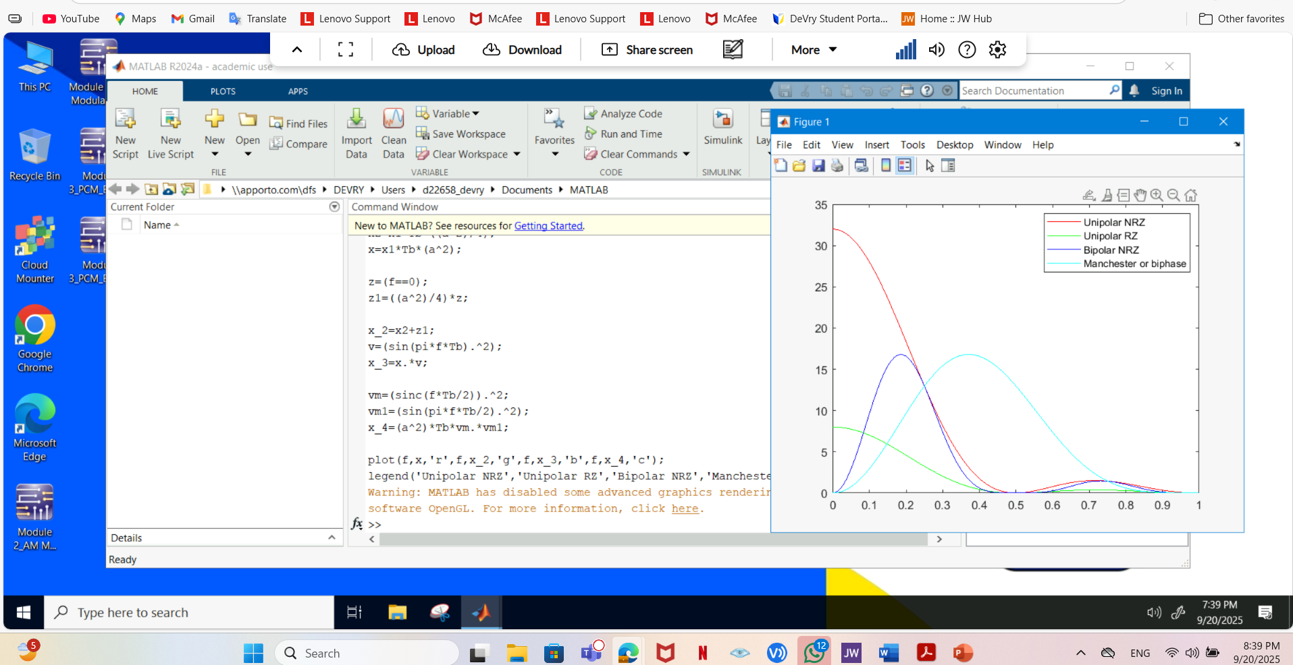
Line Codes
This screenshot should show the power spectral densities of four-line codes: NRZ-Polar, NRZ-Unipolar, NRZ-Bipolar, and Manchester-Polar.
Compare the NRZ-Bipolar and Manchester polar codes in the diagram.
Which one requires more bandwidth?
Answer:
Manchester Polar Code requires more bandwidth than NRZ-Bipolar.
Manchester encoding: Higher bandwidth due to frequent transitions.
NRZ-Bipolar encoding: Lower bandwidth, fewer transitions.
MATLAB Diagram Here

Slide 13
References
1. NETW310 Course_Project_ Guide Module 3
2. Multisim via the DeVry Desktop
3. MATLAB via the DeVry Desktop

Slide 14
NETW310 Course Project
Module 4
Cables and Structured Cabling

Slide 15
This module focuses on Cables and Structured Cabling, which are critical for building reliable network infrastructures. I answered six technical questions related to cabling standards, installation practices, and safety measures, showing both theoretical knowledge and practical understanding.
Skills Demonstrated in this project are as follows:
Networking Infrastructure Expertise: Deep understanding of structured cabling systems and standards.
Compliance & Safety Knowledge: Familiarity with ANSI/TIA/EIA and NEC guidelines.
Problem-Solving: Ability to apply theoretical principles to practical installation scenarios.
Attention to Detail: Recognizing how physical layout affects network performance.
Competence
As a technology expert this project allowed me to show my competence such as:
Shows mastery of industry standards and best practices for cabling.
Reflects ability to design and maintain safe, efficient, and high-performance networks.
Combines technical theory with real-world application, which is essential for IT and networking roles.

Slide 16
Questions
1. Why must the twisting in the individual wires be maintained in a UTP cable?
Answer:
The twisting in the individual wires of a UTP (Unshielded Twisted Pair) cable must be maintained to reduce electromagnetic interference (EMI) and crosstalk between wire pairs. This is essential for ensuring signal integrity and reliable data transmission. Standards like TIA 568, ISO 11801, and EN 50173 specify the use of twisted pairs to meet performance requirements for structured cabling systems. The twists help cancel out noise picked up along the cable’s length, which is especially important in high-frequency applications such as Category 5e, 6, 6a, and 8. Maintaining the twist ensures compliance with these standards and supports high-speed, interference-free communication.
2. How many inches should UTP cable be separated from 110 volts electrical cable?
Answer:
UTP (Unshielded Twisted Pair) cables should be separated by at least 12 inches from 110-volt electrical cables. This distance helps minimize the risk of electromagnetic interference (EMI), which can degrade signal quality and network performance. If the cables must cross, they should do so at a 90-degree angle to further reduce interference.
3. Horizontal cabling connects what areas to each other?
Answer:
Horizontal cabling connects telecommunications rooms (also known as wiring closets or intermediate distribution frames) to individual outlets or work areas within a building. This cabling forms part of the structured cabling system and typically runs through walls, ceilings, or conduits to reach desktops, phones, or other networked devices.

Slide 17
Questions
4. What is a plenum rated cable?
Answer:
A plenum-rated cable is a type of cable that is certified for use in plenum spaces—areas in buildings used for air circulation for heating and air conditioning systems, such as the space above a drop ceiling or below a raised floor.
These cables are made with fire-retardant insulation that emits low smoke and toxic fumes when exposed to fire. This makes them safer for use in air-handling spaces where fire could spread quickly.
5. What is a riser tube used for?
Answer:
A riser tube is used to transport fluids vertically between different levels in a system.
6. Is the grounding of equipment mostly a safety or a performance concern?
Answer:
Grounding of equipment is primarily for safety, though it also enhances performance. It protects people from electric shock, prevents fires, and ensures compliance with standards like ANSI/TIA/EIA and NEC. Additionally, grounding helps reduce electrical noise, maintains signal integrity, and supports surge protection. While it improves system performance, its main purpose is to ensure safety.

Slide 18
References
FS website. Link: Wiring Standards: TIA 568 / ISO 11801 / EN 50173
2. New Cabling Standards for the Buildings of Today and Tomorrow by Frank Straka, Link: new-cabling-standards-for-the-buildings-of-today-and-tomorrow.pdf
3. ANSI-TIA-EIA, Link: ANSI-TIA-EIA-568-B.pdf
…

Slide 19
NETW310 Course Project
Module 5
Antenna Gain and Free Space Path Loss

Slide 20
This module involves analyzing antenna gain and free space path loss for different frequencies and distances. These calculations are essential for radio theory and link planning in WLAN (Wireless LAN) environments.
Skills Demonstrated in this project are as follows:
Wireless Networking Knowledge: My understanding of WLAN link planning and radio theory.
Analytical Skills: Accurate calculations using formulas and scientific tools.
Problem-Solving: Ability to interpret results and explain relationships (frequency vs. gain, distance vs. loss).
Real-World Application: Linking theoretical concepts to practical systems like VLA telescopes.
Competence
As a technology expert this project allowed me to show my competence such as:
Demonstration of my ability to use scientific calculators, apply logarithmic formulas, and validate results against theoretical models—skills essential for RF planning and troubleshooting.

Slide 21
Antenna Gain
1. What is the maximum theoretical antenna gain of a common dish antenna at the 2.4 GHz band? [4 points]
Answer: 22.379
2. What is the maximum theoretical antenna gain of a common dish antenna at the 5 GHz band? [4 points]
Answer: 29.079
3. Given the same sized reflector, which signals, high-frequency, or low-frequency, can be more efficiently focused by a common dish antenna (i.e., result in a higher antenna gain)? [5 points]
Answer: High Frequency
4. What is the maximum theoretical antenna gain of the dish antenna used in the VLA radio telescopes in New Mexico at the 5 GHz band? [4 points]
Answer: 63.059
5. Given the same signal frequency, which dish antennas, large-sized or small-sized, are more efficient at focusing the signal (i.e., result in a higher antenna gain)? [5 points]
Answer: Large-sized dish antenna

Slide 22
Free Space Path Loss
1. What is the free space path loss in dB at the 2.4 GHz band? [4 points] Answer: -80.4
2. What is the free space path loss in dB at the 5 GHz band? [4 points] Answer: -87.2
3. How does the free space path loss at a higher frequency (e.g., the 5 GHz band) compare with that at a lower frequency (e.g., the 2.4 GHz band)? [5 points]
Answer: signals at 5 GHz lose more power in free space than those at 2.4 GHz. Because Free space path loss increases with frequency. This means that at a higher frequency like 5 GHz, the signal experiences more attenuation over the same distance compared to a lower frequency like 2.4 GHz.
4. What is the free space path loss in dB over 20 meters at the 2.4 GHz band? [4 points]
Answer: -66.421
5. What is the free space path loss in dB over 40 meters at the 2.4 GHz band? [4 points]
Answer: -72.441
6. What is the free space path loss in dB over 80 meters at the 2.4 GHz band? [4 points]
Answer: -78.462
7. When the distance doubles, how does free space path loss in dB change approximately? [5 points]
Answer: When the distance doubles, the free space path loss increases by approximately 6 db.

Slide 23

Free Space Path Loss Cont.
8. Use a scientific calculator to calculate Delta $L_{fS}$ for D1 = 20 meters and D2 = 40 meters. [4 points]
ΔLfS​=20log10​(D1​D2​​)=20log10​(2040​)=20log10​(2)≈20×0.3010=6.02dB
Delta $L_{fS }$= 6.02 dB
9. Is your calculation approximately the same as the result from Part 1 Step 2? [4 points]
Answer: Yes, the calculated change in free space path loss (6.02 dB) is approximately the same as the observed difference between 20 meters (-60.4 dB) and 40 meters (-66.4 dB), which is 6 dB.

Slide 24
References
1. NETW310 Module 5, Course projects, Antenna Gain and Free Space Path Loss
2. Radio theory and link planning for Wireless LAN (WLAN)
3. Scientific Calculator.

Slide 25
NETW310 Course Project
Module 6
Bit Error Rate of Fading Channels

Slide 26
This module focuses on analyzing Bit Error Rate (BER) performance of fading channels, which is a critical concept in wireless communication and digital signal processing.
Skills Demonstrated in this project are as follows:
Wireless Communication Fundamentals: Deep understanding of noise and fading effects on signal integrity.
Analytical Skills: I can compare performance metrics and explain why AWGN outperforms Rician.
Problem-Solving: Linking BER results to practical implications for system design (e.g., why fading mitigation is necessary).
Simulation Proficiency: Hands-on experience with industry-standard tools like Multisim.
Competence
As a technology expert this project allowed me to show my competence such as:
I demonstrated the ability to interpret BER curves, understand channel impairments, and quantify performance differences using logarithmic scales.
I reflect proficiency in simulation tools, digital modulation techniques, and wireless channel modeling, which are vital for careers in network engineering, RF design, and cybersecurity for wireless systems.

Slide 27
Free Space Path Loss
1. What is the free space path loss in dB at the 2.4 GHz band? [4 points] Answer: -80.4
2. What is the free space path loss in dB at the 5 GHz band? [4 points] Answer: -87.2
3. How does the free space path loss at a higher frequency (e.g., the 5 GHz band) compare with that at a lower frequency (e.g., the 2.4 GHz band)? [5 points]
Answer: signals at 5 GHz lose more power in free space than those at 2.4 GHz. Because Free space path loss increases with frequency. This means that at a higher frequency like 5 GHz, the signal experiences more attenuation over the same distance compared to a lower frequency like 2.4 GHz.
4. What is the free space path loss in dB over 20 meters at the 2.4 GHz band? [4 points]
Answer: -66.421
5. What is the free space path loss in dB over 40 meters at the 2.4 GHz band? [4 points]
Answer: -72.441
6. What is the free space path loss in dB over 80 meters at the 2.4 GHz band? [4 points]
Answer: -78.462
7. When the distance doubles, how does free space path loss in dB change approximately? [5 points]
Answer: When the distance doubles, the free space path loss increases by approximately 6 db.

Slide 28
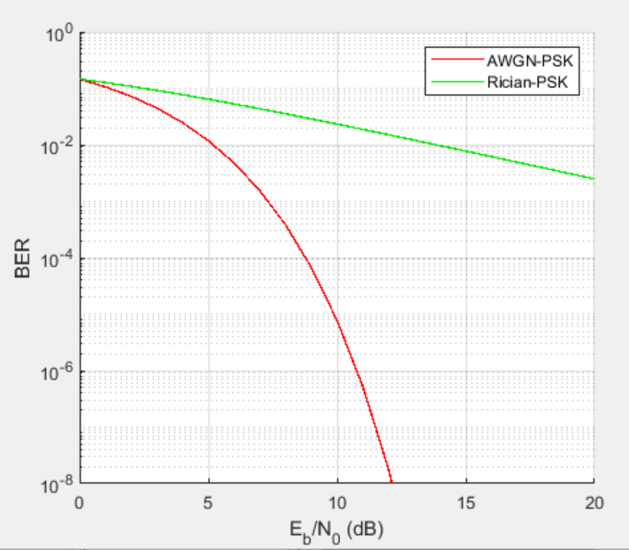
AWGN Channel and Rician Channel
This screenshot should show the bit rate error performance of both AWGN and Rician fading channels.

Slide 29
AWGN Channel and Rician Channel
Compare and contrast the BER performance of PSK over a noise limited (AWGN) transmission channel to the performance of PSK over a Rician channel at 5- and 10-dB Signal to Noise Ratio (E_{b}/N₀), respectively.
Is there a significant difference in BER performance of PSK between the AWGN channel and Rician channel?
Answer:
There is a significant difference in BER performance between AWGN and Rician channels for PSK modulation.
AWGN channel shows better performance with lower BER at both 5 dB and 10 dB SNR levels.
At 5 dB Eb/N₀:
AWGN Channel: BER ≈ between 10⁻³ and 10⁻⁴
Rician Channel: BER ≈ 10⁻²
AWGN performs better with significantly lower error rate.
At 10 dB Eb/N₀:
AWGN Channel: BER ≈ below 10⁻⁶
Rician Channel: BER ≈ around 10⁻³
AWGN outperforms Rician channel.

Slide 30
References
1. NETW310 CP Guide Module 6
2. Multisim 14.3
3. DeVry Desktop
……

Slide 31
CHALLENGE
When I was failing to get the expected result, I was contacting my Professor who could explain again to me the part that I was not able to understand when they were lecturing.
CONCLUSION
Through these comprehensive modules, I have demonstrated mastery of core principles in signal processing, wireless communication, and network infrastructure, combining theoretical knowledge with practical implementation. My ability to perform precise calculations, develop mathematical models, and utilize industry-standard tools such as Multisim, MATLAB, oscilloscopes, and spectrum analyzers reflects strong analytical and problem-solving skills. These projects showcase my competence in designing, analyzing, and optimizing communication systems, positioning me as a technology expert capable of delivering innovative solutions in networking, RF engineering, and cybersecurity.

