Slide 1
FINAL PROJECT
Fiston Kadetwa BAHATI
Information Technology and Networking/Cyber Security, DeVry University
SEC290
Fundamentals of Infrastructure Security
Professor Jacob Mack
      June 27, 2025

Slide 2
This project which is the final one of my course above mentioned, shows the infrastructure security implementation skills that I currently have, which I acquired from the live lessons, practice labs that we performed during the course period and most important from the advices, support and guidance from my Professor Jacob.
The screenshot that you will find in this project, were taken by myself after completing the tasks that I was assigned to do.
Each slide contains explanation of what I was asked to do. There is a slide that introduce the screenshots for good understanding of the content.

Slide 3
Among the skills that I acquired, I will name the majors and important that cover everything in general:
Threat Intelligence,
Identification of Security Vulnerabilities,
Cloud Security,
Security Data Analysis,
Incidence Response,
Risk Management,
And IT Regulatory Compliance.

Slide 4
Intrusion Analysis using Wireshark

Slide 5
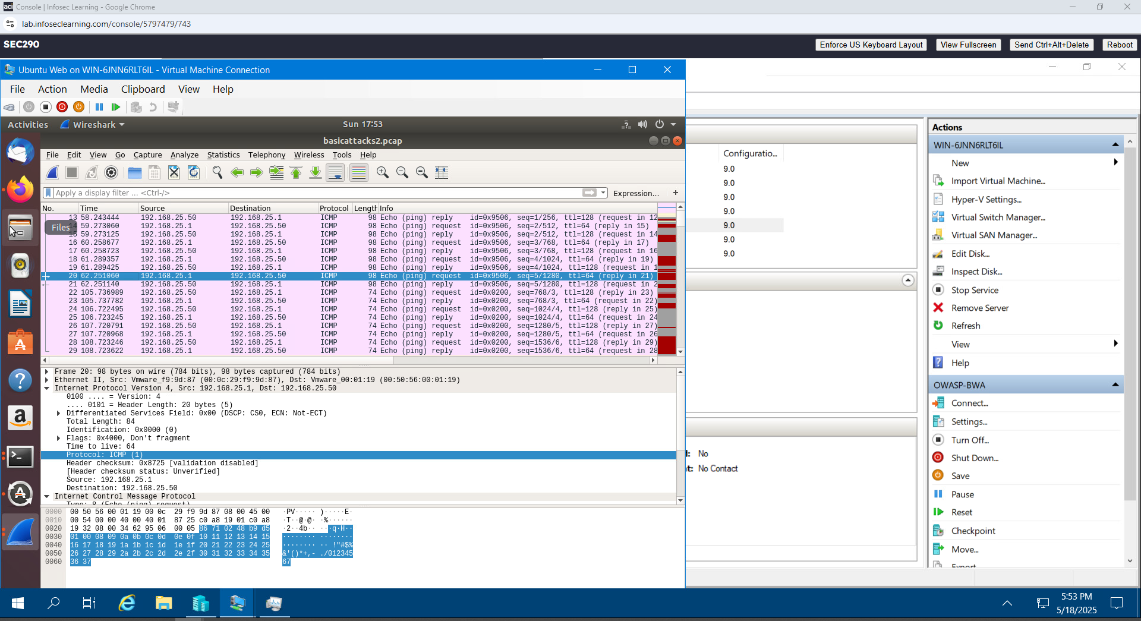
Basic attack analysis
Look at captures no. 20 and 22. (You can use the “Go” link at the top of the Wireshark screen to quickly go to a specific capture) Both packets are ICMP traffic but there are subtle differences between them. Compare the time-to-live and data field sizes in the two packets. What differences do you see?
Time to live for capture no. 20 is 64. Unlike the Time to live for capture no. 22 is 128.
The data field size for capture no. 20 is 56 bytes. But the data field size for capture no. 22 is 32 bytes
The other differences I noticed on the 2 files are as follows:
Capture no. 20 has 98 as length of packets; the response frame is 21; the IP source is 192.168.25.1 and the IP destination is 192.168.25.50;
Capture no. 22 has 74 as length of packets; the response frame is 23; the IP source is 192.168.25.50 and the IP destination is 192.168.25.1;

Slide 6
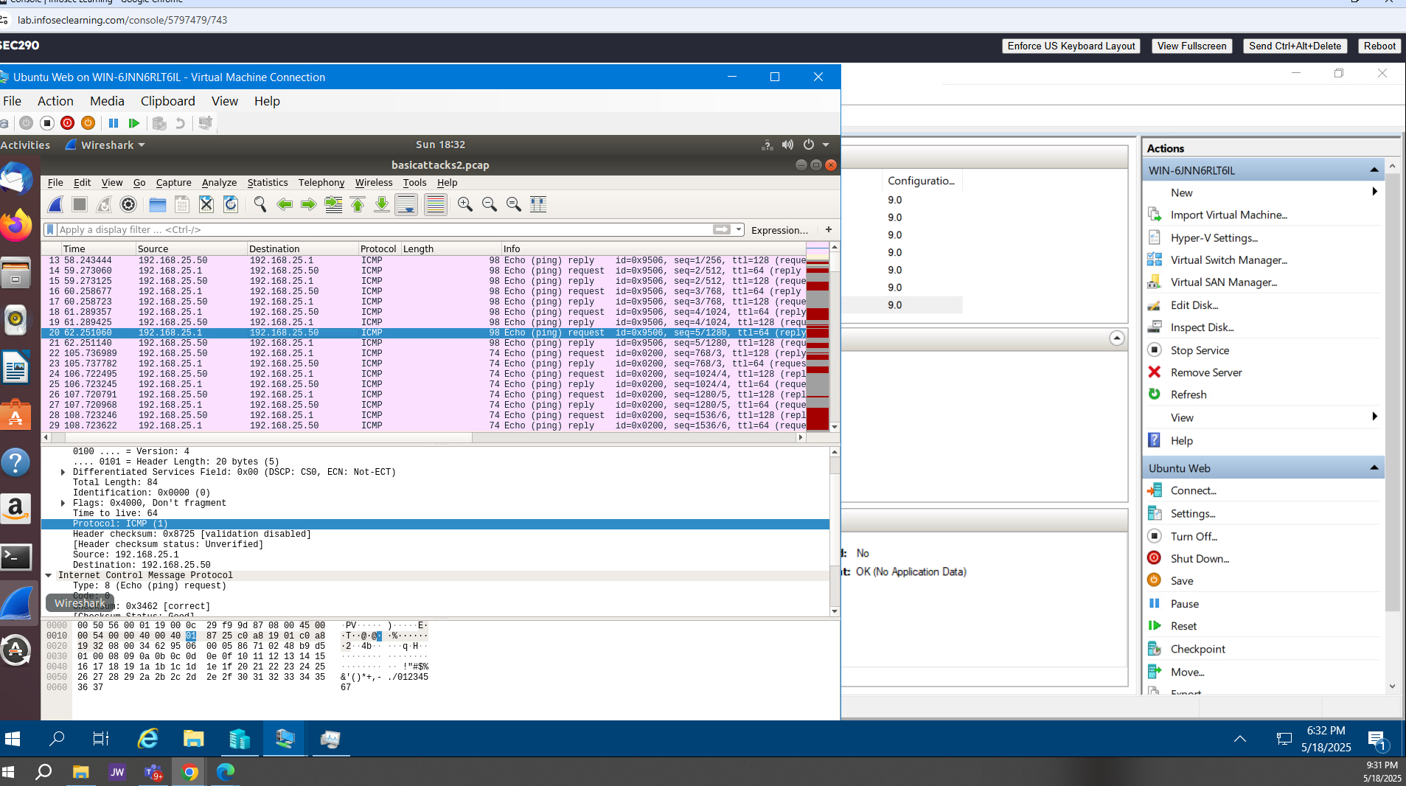
2. Do a little Internet research to discover which operating systems use the specific values in their ping commands. What operating system generated the echo request in capture 20?​
According to the YouTube channel "Network Encyclopedia", the OS Linux Kernel 4.10 (2015) and the OS Mac (2001) generated the echo request in capture 20.

Slide 7
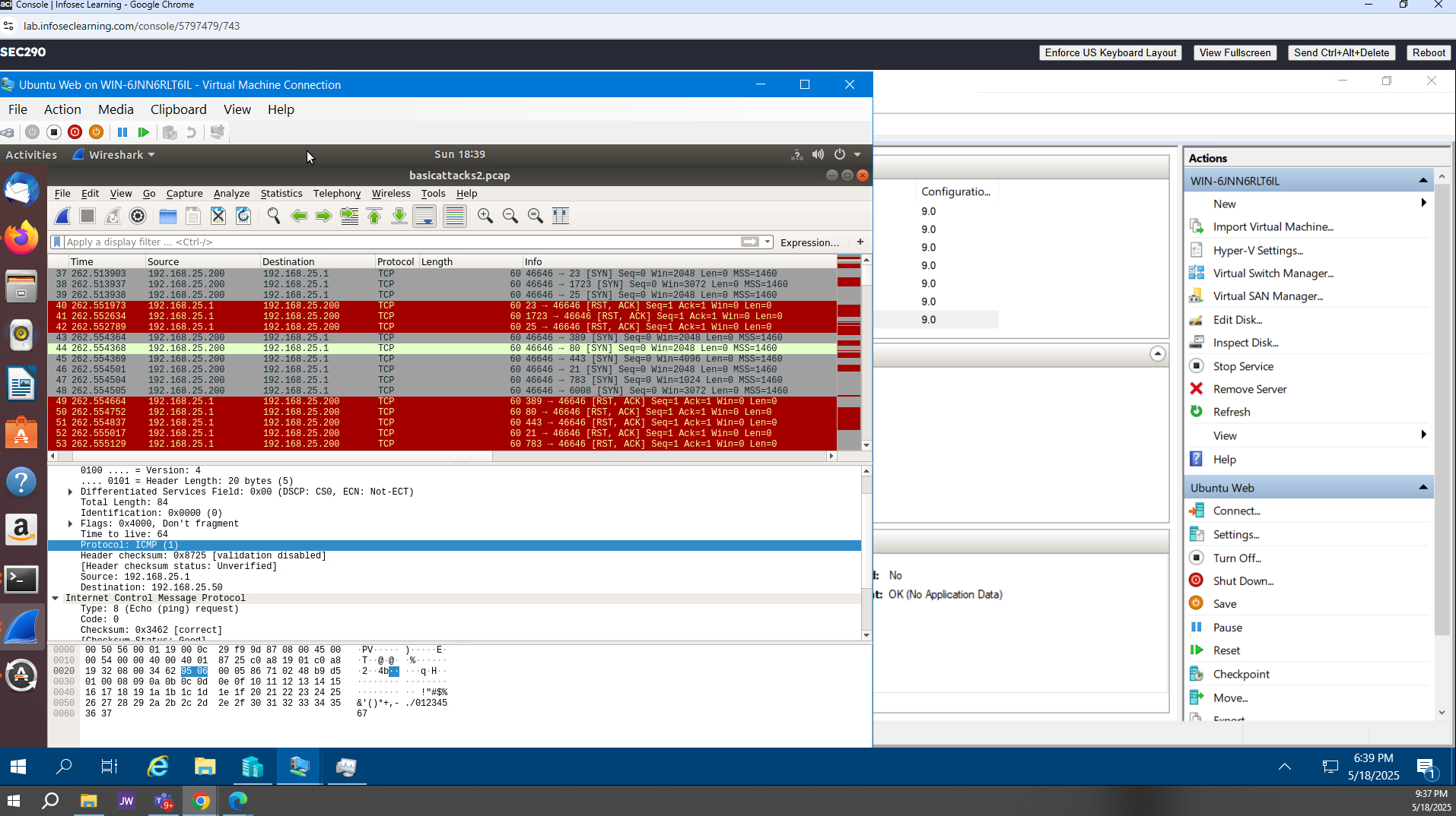
Review packet no. 37 and beyond, what do you think is taking place here?
I see the TCP traffic on all those packets, and the length is identical, 60.

Slide 8
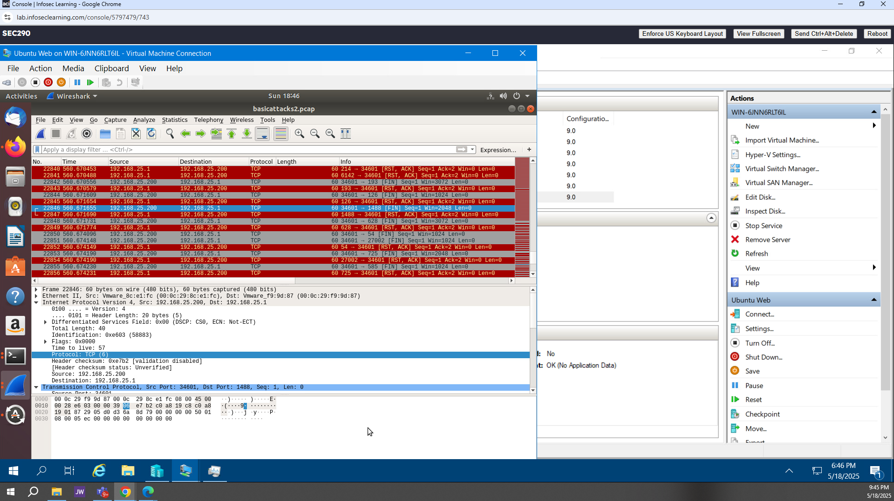
Look at capture 22846. What is suspicious about the flag settings in this packet?​

Slide 9
5. What is the IP address of the host being targeted? ​
The IP address of the host that is being targeted is 192.168.177.47

Slide 10
Open SSL

Slide 11
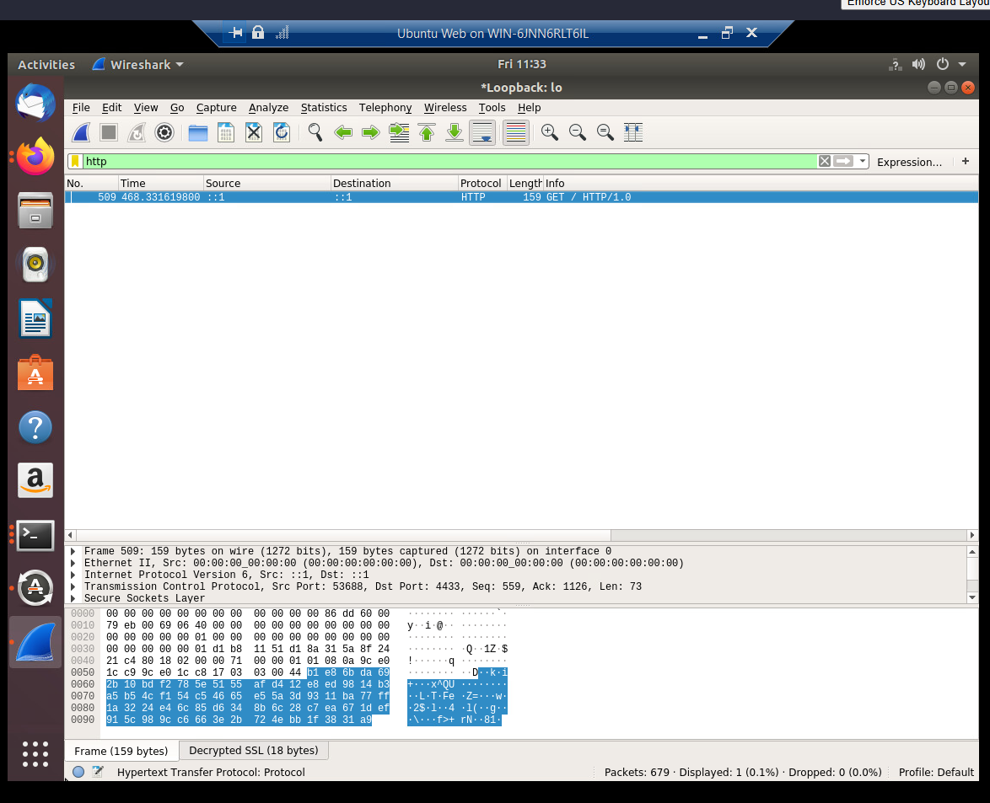
Creating and testing an SSL/TLS file
Take a screenshot of the output in Step 20.
It should show the GET request in the Info column.

Slide 12
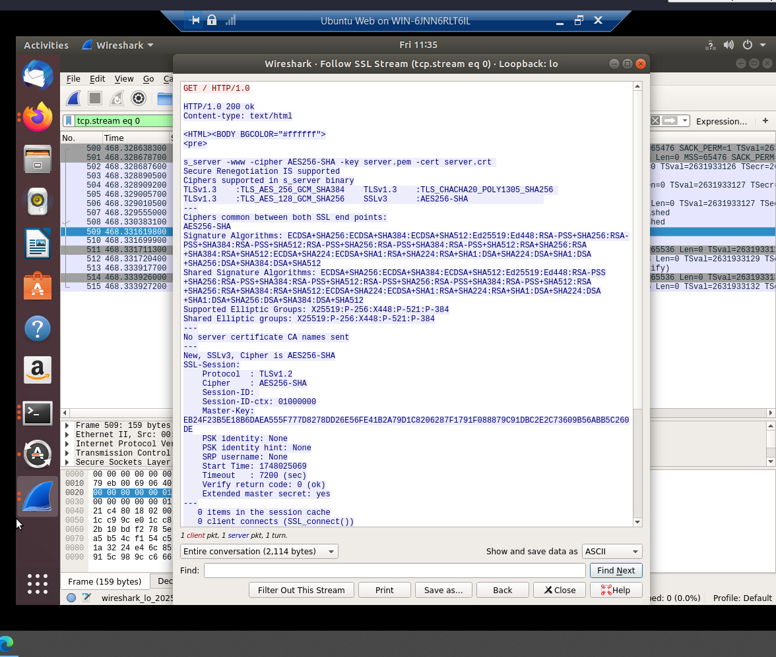
Creating and testing an SSL/TLS file cont’d
Take a screenshot of the output in Step 22.
It should show the decrypted SSL stream.

Slide 13
References
DeVry University-SEC 290 V2- Fundamentals of Infrastructures Security- Module 3 project video: Open SSL analysis, Output step 20
DeVry University-SEC 290 V2- Fundamentals of Infrastructures Security- Module 3 project video: Open SSL analysis, Output step 22

Slide 14
Snort

Slide 15
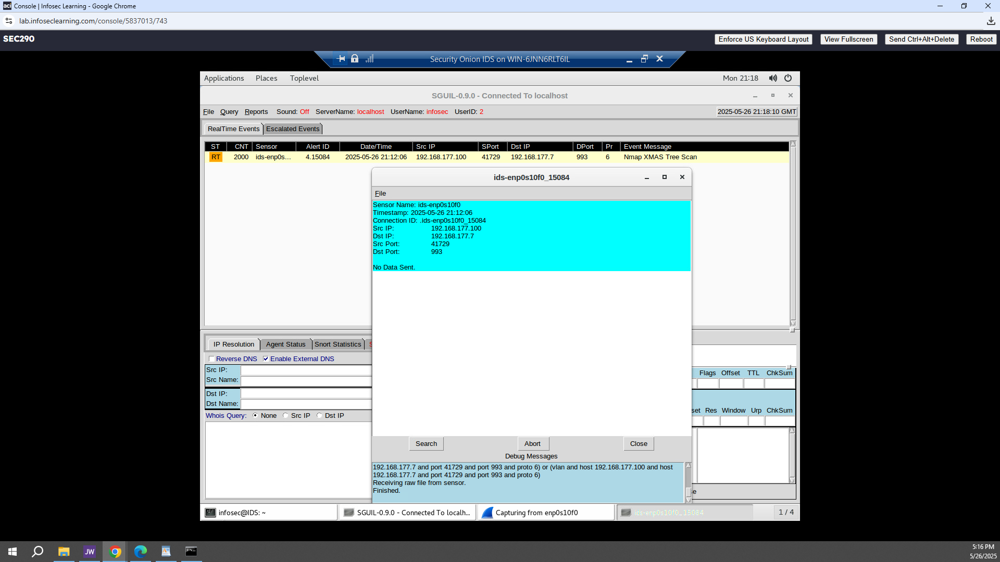
Testing Snort rules
Take a screenshot of the output in Part 1 Step 17.
It should show the transcript of the XMAS scan alert.

Slide 16
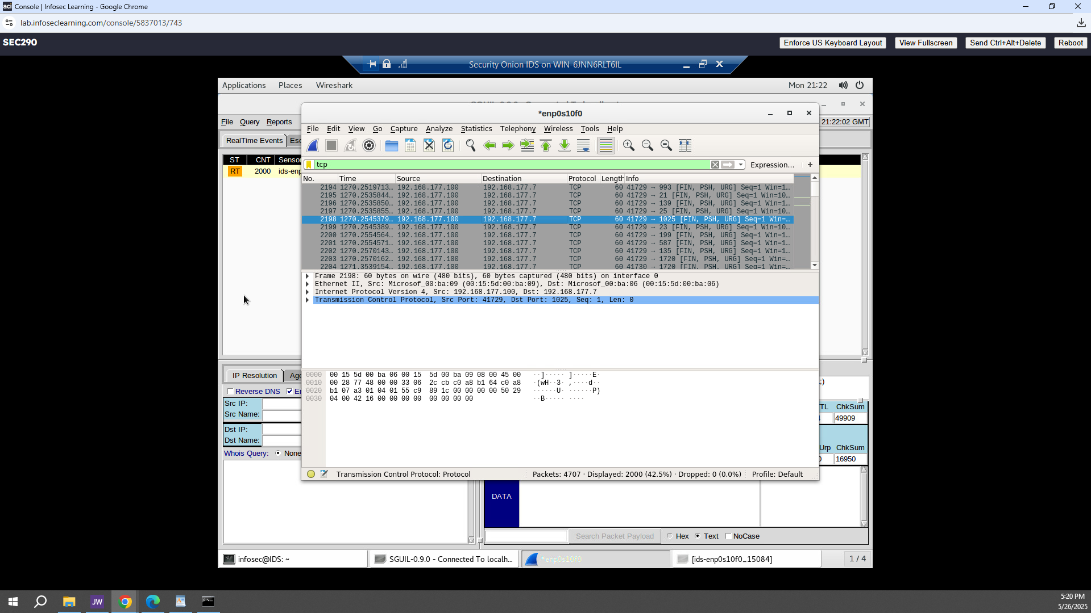
Testing Snort rules cont’d
Take a screenshot of the output in Part 1 Step 20.
It should show the TCP packets generated by the XMAS scan.

Slide 17
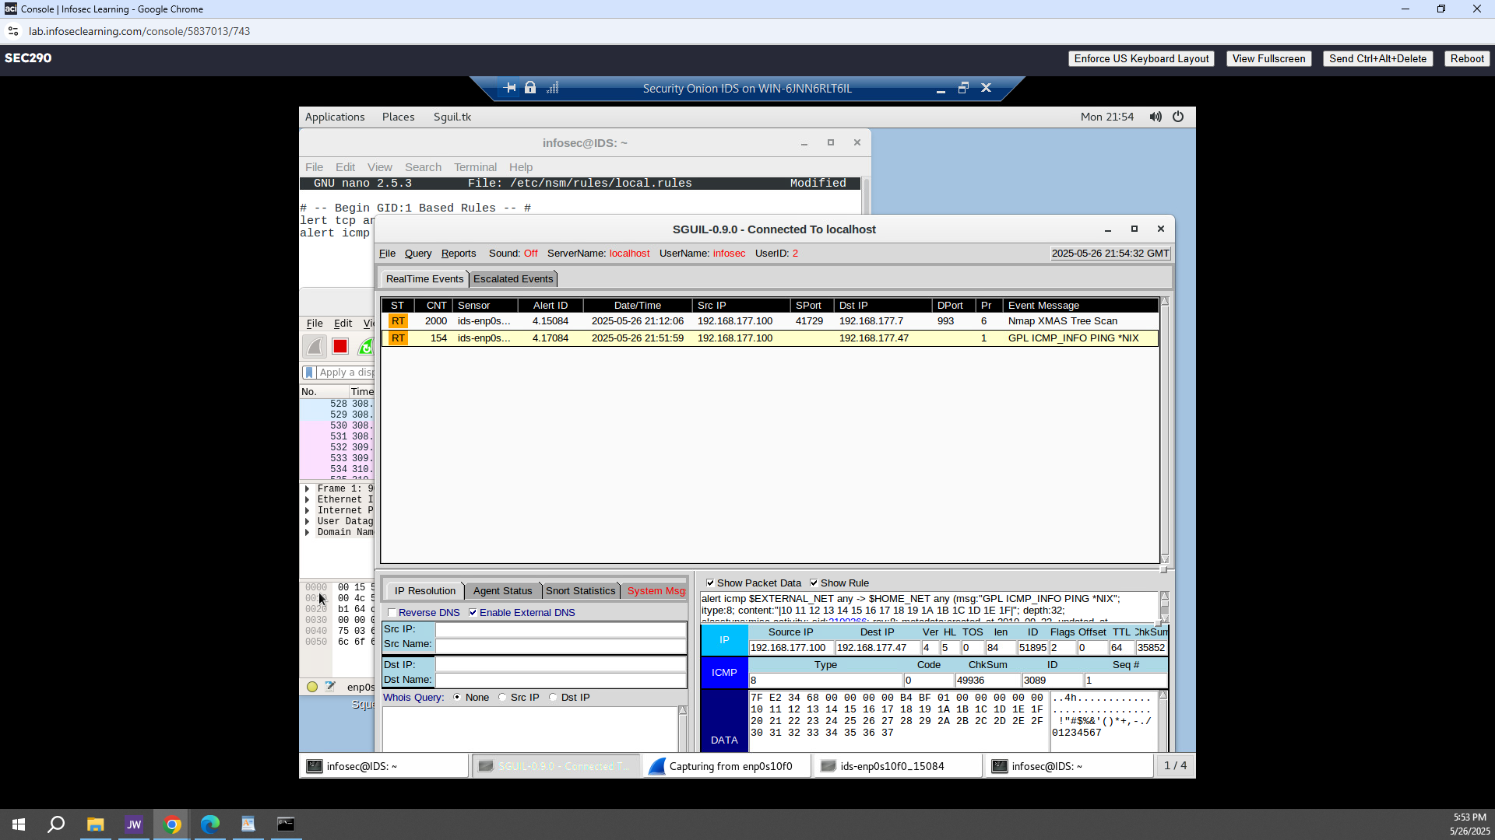
Creating Snort rules
Take a screenshot of the output in Part 2 Step 7.
It should show the ping activity alert.

Slide 18
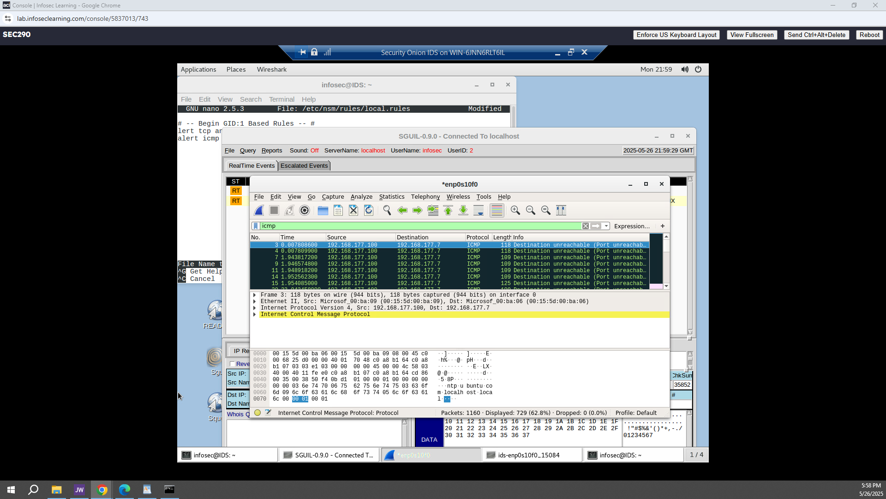
Creating Snort rules cont’d
Take a screenshot of the output in Part 2 Step 8.
It should show the ICMP packets generated by the ping activity.

Slide 19
Live Memory Analysis

Slide 20
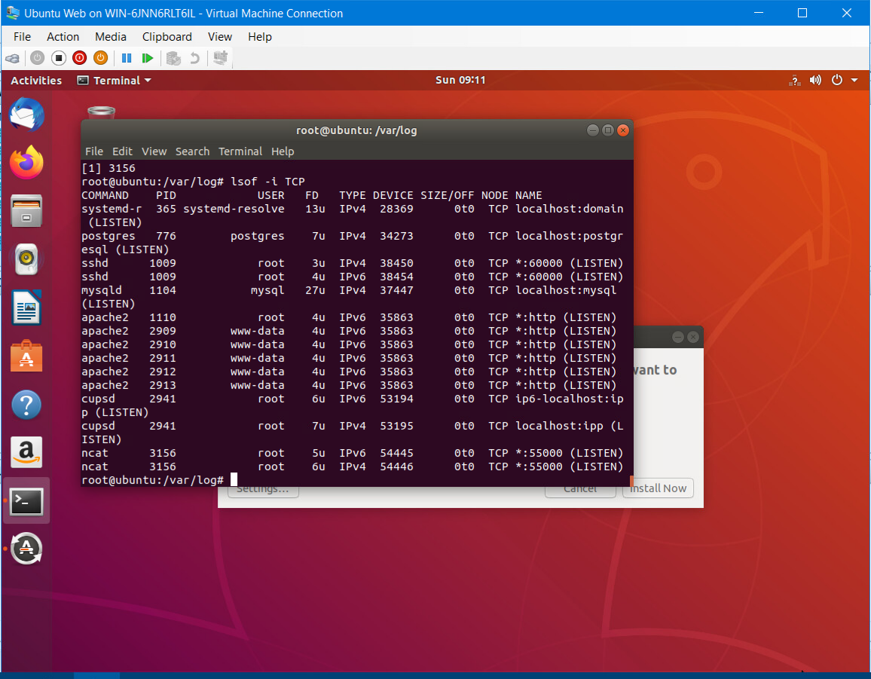
Linux Processes
Take a screenshot of the output in Part 1, Step 16.
It should show port 55000 open for both IPv4 and IPv6.

Slide 21
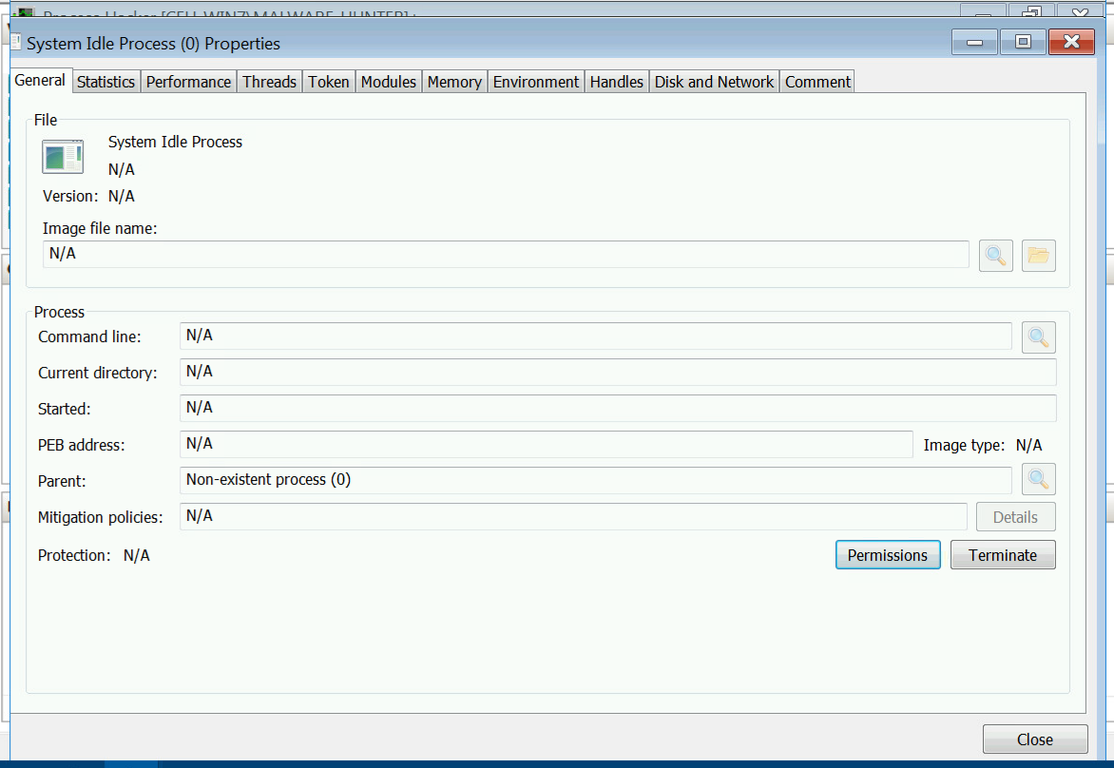
Process Hacker
Take a screenshot of the output in Part 2, Step 5.
It should show properties of a chosen process.

Slide 22
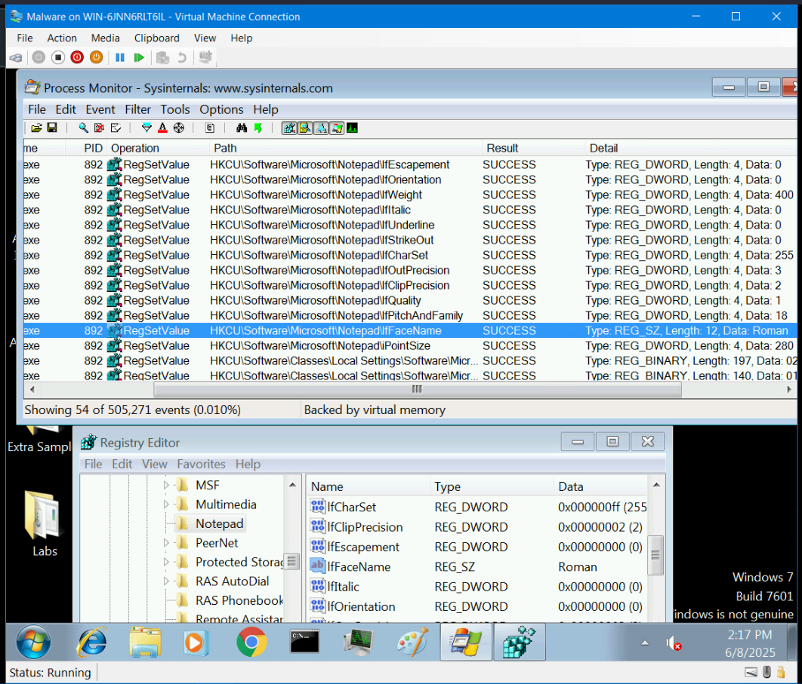
Process Monitor
Take a screenshot of the output in Part 3, Step 13.
It should show ifFaceName in the Path column and Data: Roman in the Detail column.

Slide 23
References
DeVry University - SEC 290 V2 – Fundamentals of Infrastructure Security – Module 5 : Live Memory Analysis, Part 1, Linux Processes, step 16
2. DeVry University - SEC 290 V2 – Fundamentals of Infrastructure Security – Module 5 : Live Memory Analysis, Part 2, Process Hacker, step 5
3. DeVry University - SEC 290 V2 – Fundamentals of Infrastructure Security – Module 5 : Live Memory Analysis, Part 3, Process Monitor, step 13

Slide 24
Firewall

Slide 25
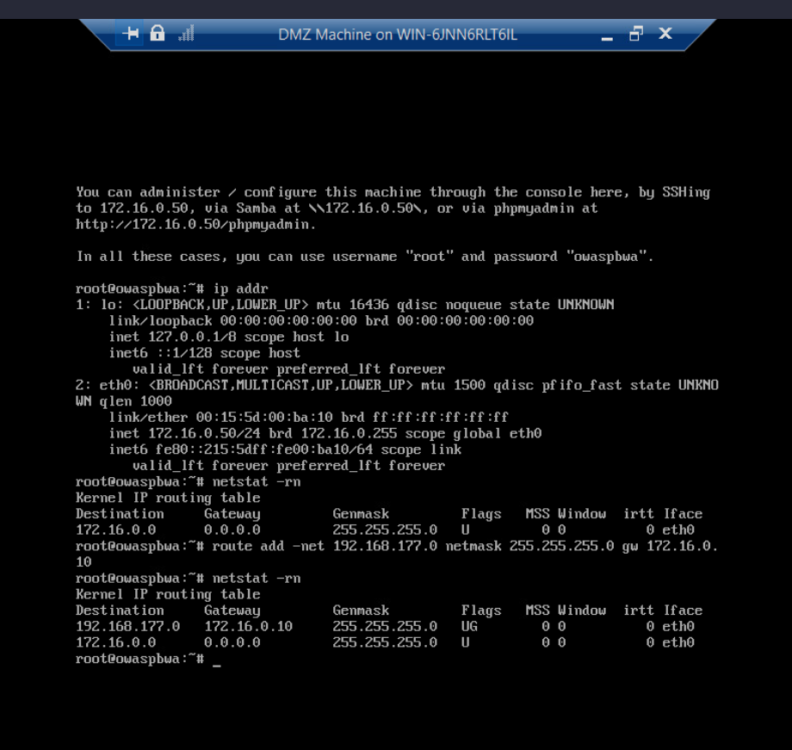
Time-based Access
Take a screenshot of the output in Part 1 Step 21.
It should show the output of the DMZ Route Table.

Slide 26
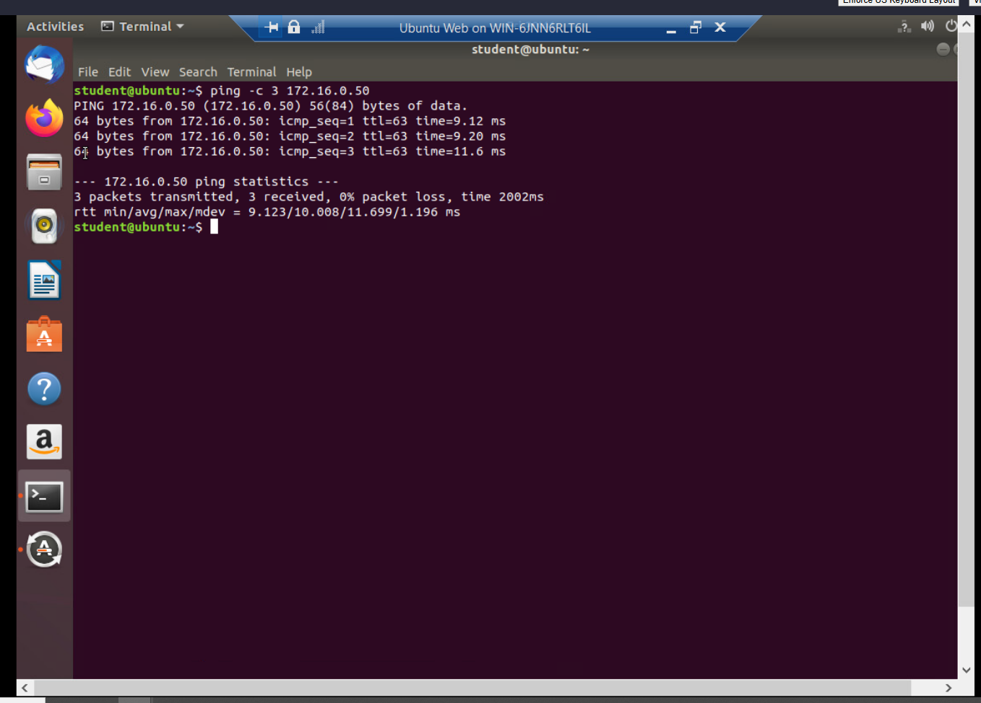
Time-based Access
Take a screenshot of the output in Part 1 Step 26.
It should show a successful ping from the Ubuntu Web VM and the DMZ VM.

Slide 27
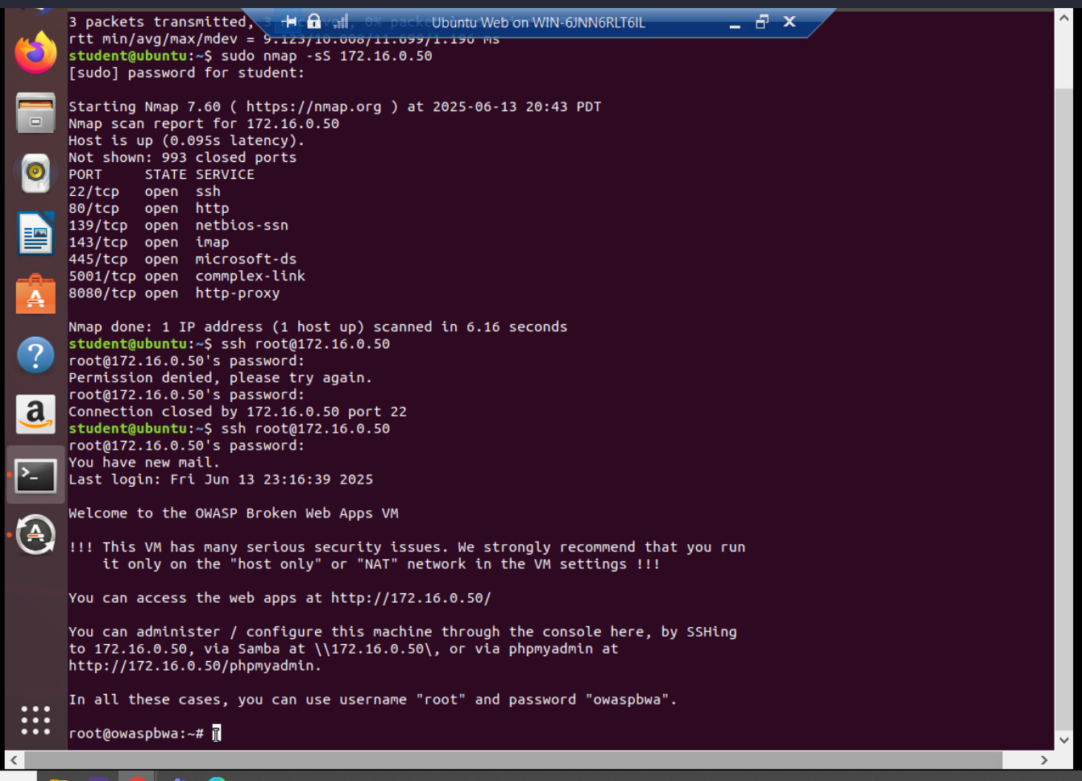
Time-based Access
Take a screenshot of the output in Part 1 Step 34.
It should show two time-based access rules in the FORWARD chain

Slide 28
References
DeVry University – SEC 290 V2- Fundamentals of Infrastructure Security – DeVry SEC 290 – Module 6: Firewall, Time-Based Access, Part 1 Step 21
DeVry University – SEC 290 V2- Fundamentals of Infrastructure Security – DeVry SEC 290 – Module 6: Firewall, Time-Based Access, Part 1 Step 26
DeVry University – SEC 290 V2- Fundamentals of Infrastructure Security – DeVry SEC 290 – Module 6: Firewall, Time-Based Access, Part 1 Step 34

Slide 29
Conclusion
This project is the result and the outcome of the efforts I put during the eight weeks of learning; using course materials such as ITPRO.TV, Live lessons and recordings, huddles sessions with our Professors, and research.
But during the learning period, I encountered many challenges that were hindering me from completing my tasks. For instance, while performing in a project, because we used a Virtual Machine that could allow us to access many different Operating Systems through InfoSec Learning and Devry Hyper-V window; the time set might stop without me giving attention, and that would make me restart the whole process from the beginning, yet I was at an advanced step. It is frustrating. But by accepting to start again, the task will be completed with no interruptions. Or a misspelling error might block the continuation or the flaw of a code or script that I would be working on. In that case, I could just contact my Professor and explain in detail the challenge encountered, and they would provide me with guidance and make me notice my mistakes then correct them.

